Slide 1
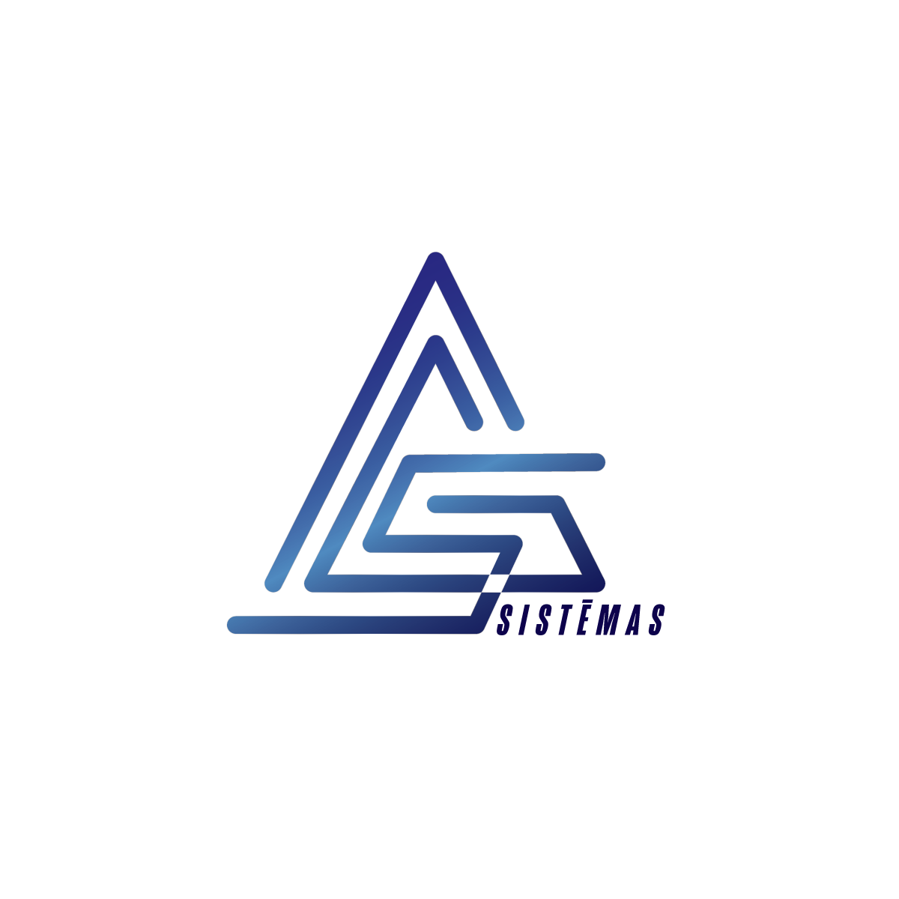
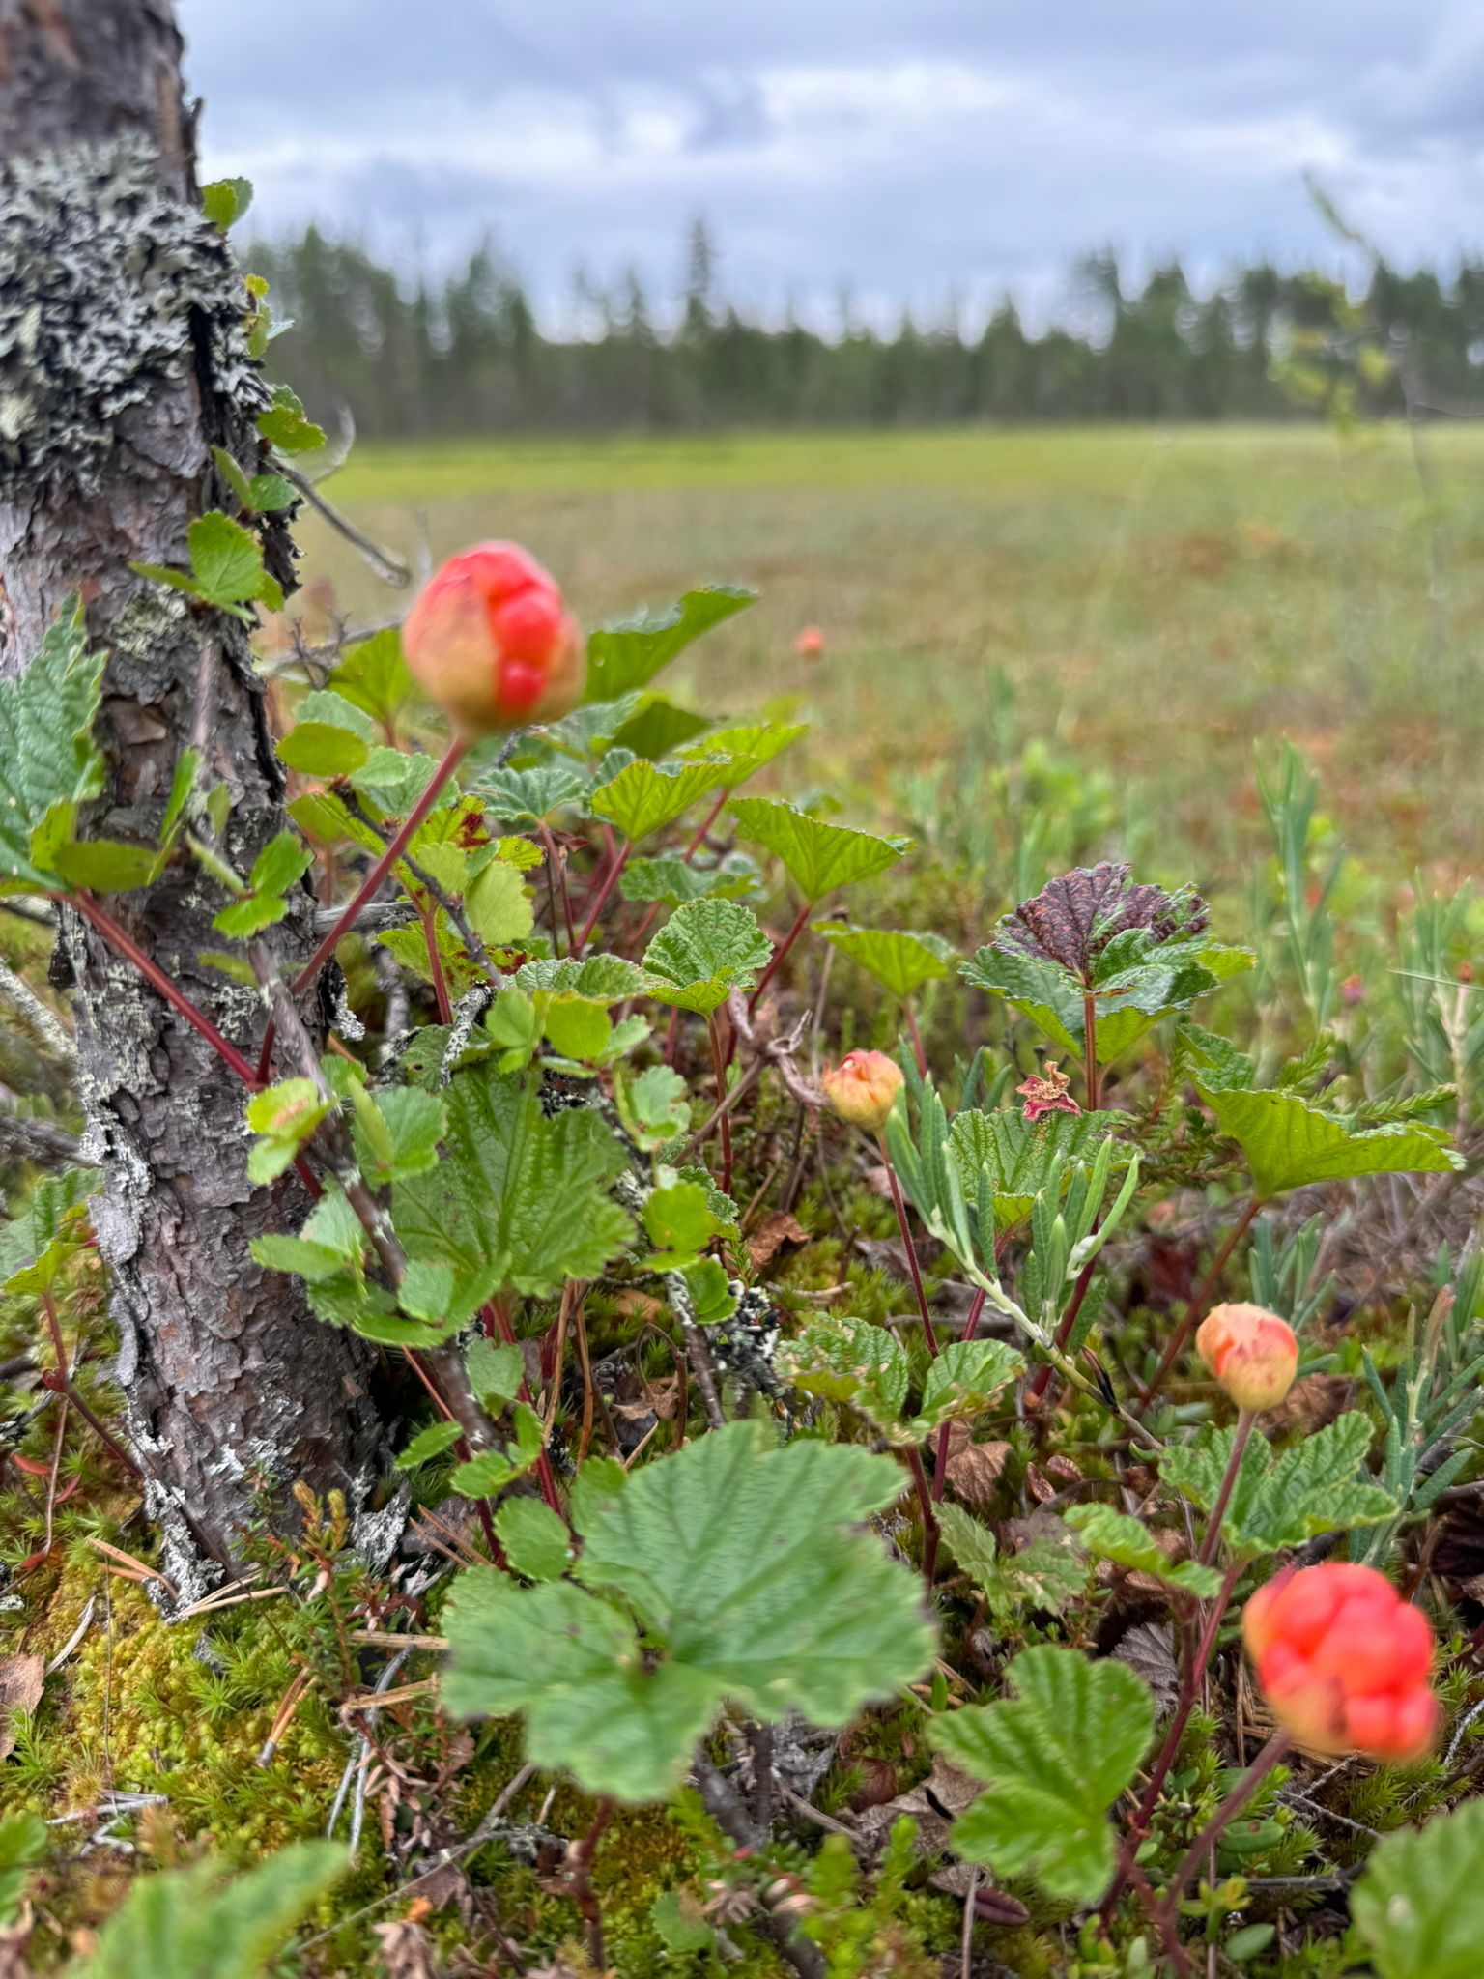


Overview of the activities AGS Sistēmas SIA 14.11.2025. EU LIFE Programm project “Peatland restoration for greenhouse gas emission reduction and carbon sequestration in the Baltic Sea region” 101074396 - LIFE21-CCM-LV-LIFE Peat Carbon

Slide 2
WP 2: Procurement «Development of a technical designs for stabilizing the hydrological regime in the Nature reserves «Cenas Mire» and «Lielais Pelečāres Mire»» (Purva hidroloģiskā režīma stabilizēšanas tehniskā projekta izstrāde dabas liegumos “Cenas tīrelis” un “Lielais Pelečāres purvs”)
The procurement was carried out in accordance with Regulation No. 104 of the Republic of Latvia (adopted on 28 February 2017), "Regulations Regarding Procurement Procedure and Procedures for Application Thereof to Projects Financed by a Contracting Authority".
Subject: hydrotechnical project, survey, pegs placing, topography;
Sent by email 05.06.2024.; finished on 25.06.2024.;
Invited by SIA «DDP»; agreement sign on 26.07.2024.

Slide 3
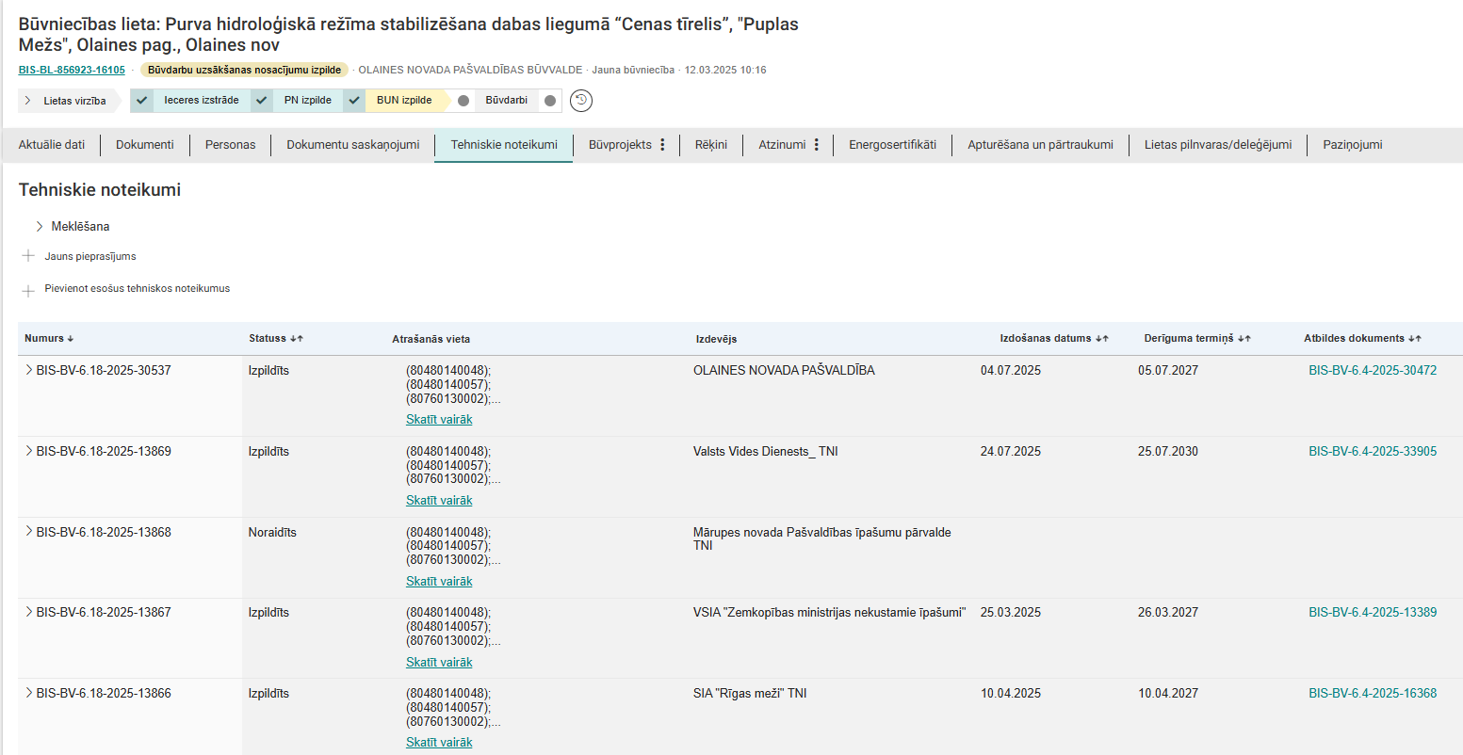
Construction file: Purva hidroloģiskā režīma stabilizēšana dabas liegumā “Cenu tīrelis” Building Information System (BIS) No. BIS-BL-856923-16105 from 12.03.2025.
Technical specifications

Slide 4
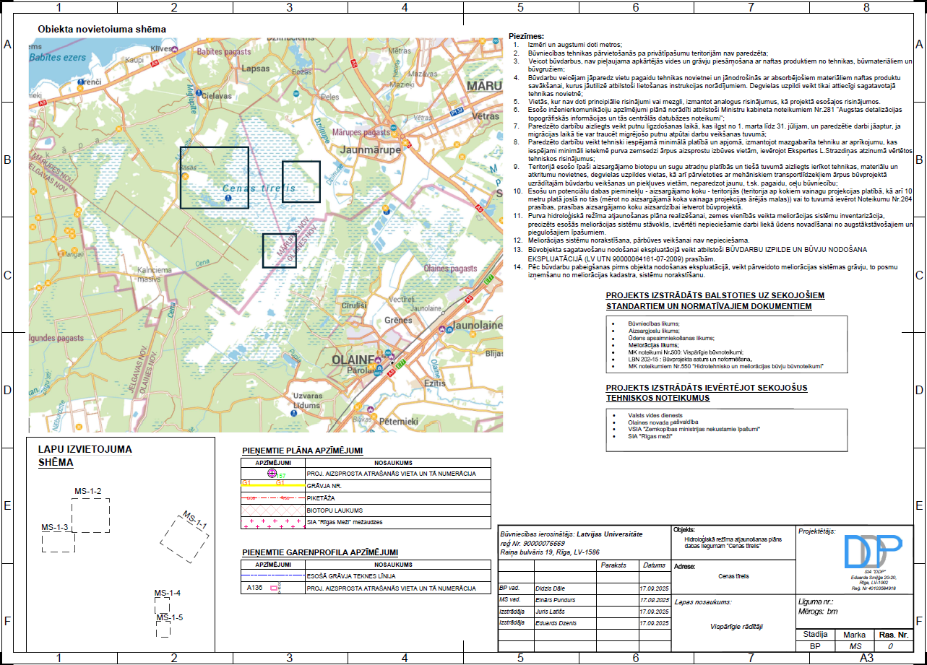
Construction design:

Slide 5
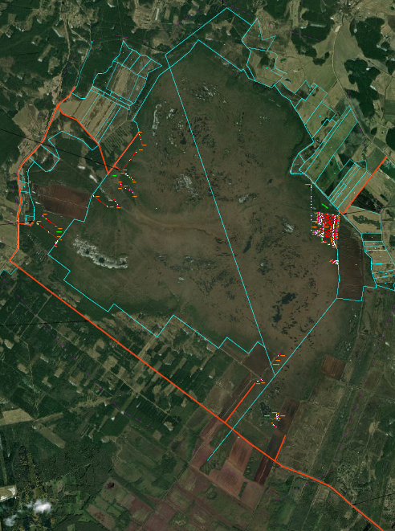
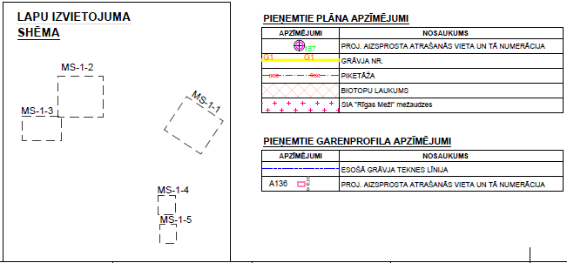
Construction design:

Slide 6
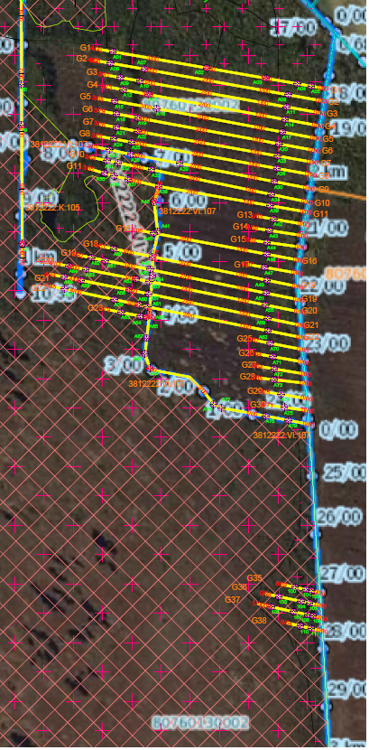
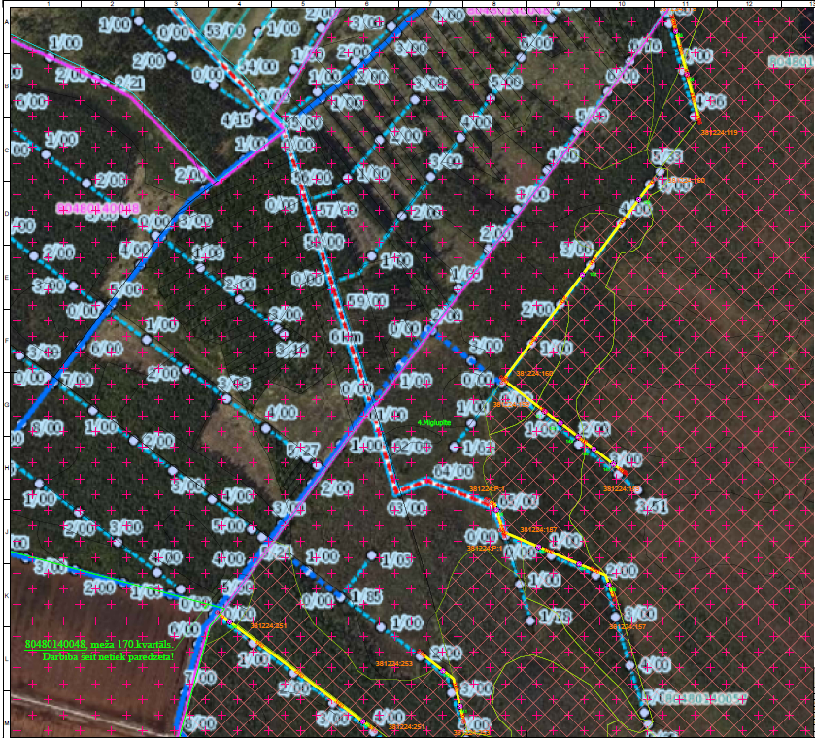
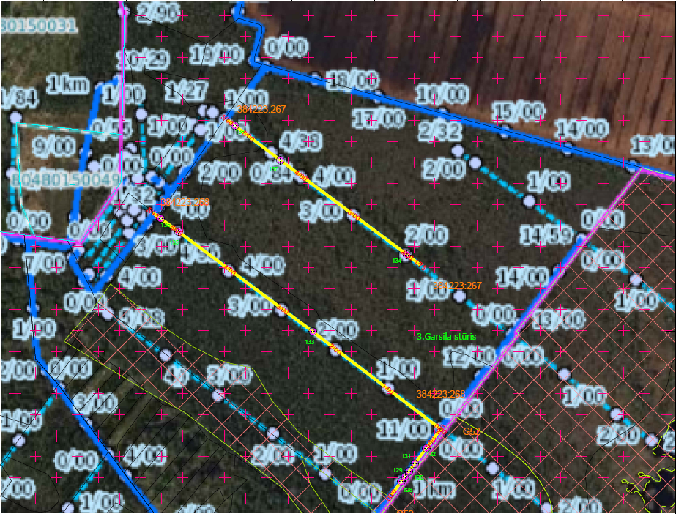
Construction design: MS1-1
Construction design: MS1-2
Construction design: MS1-3

Slide 7
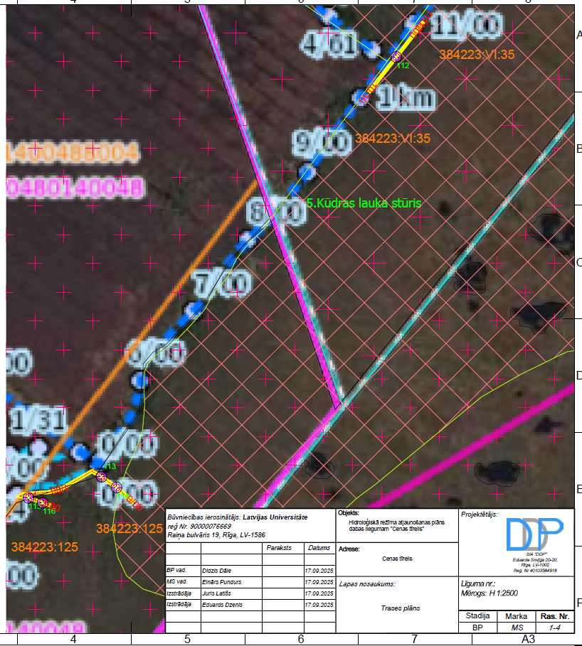
Construction design: MS1-4
Construction design: MS1-5

Slide 8
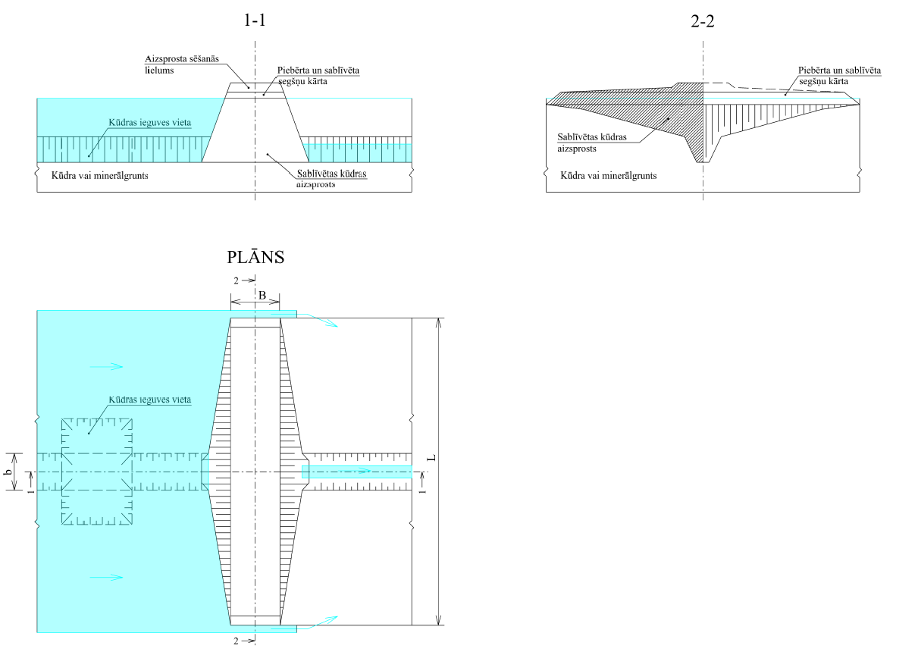
Construction design: Peat dam.

Slide 9
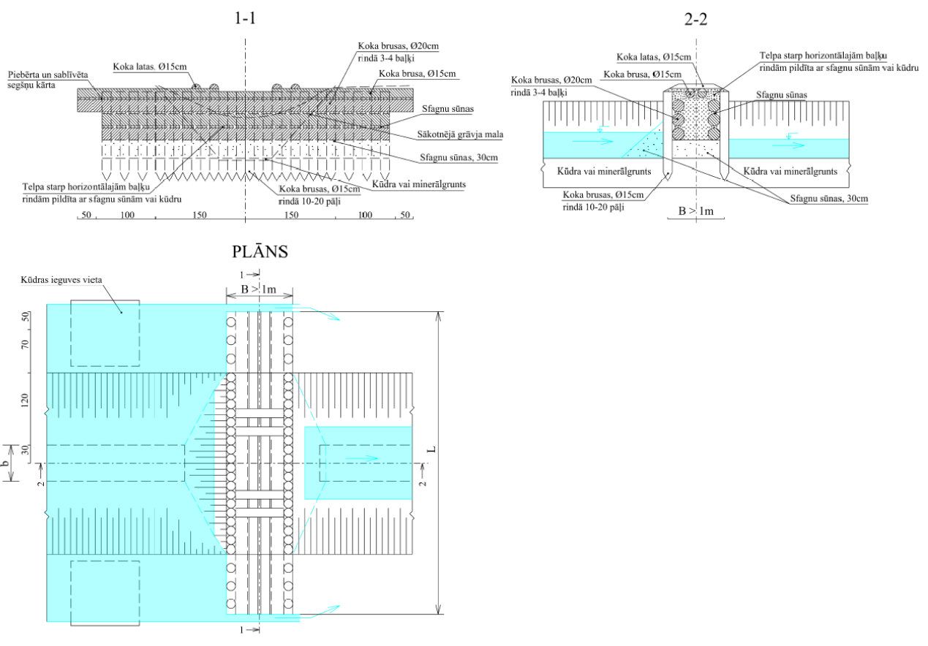
Construction design: Wood dam.

Slide 10
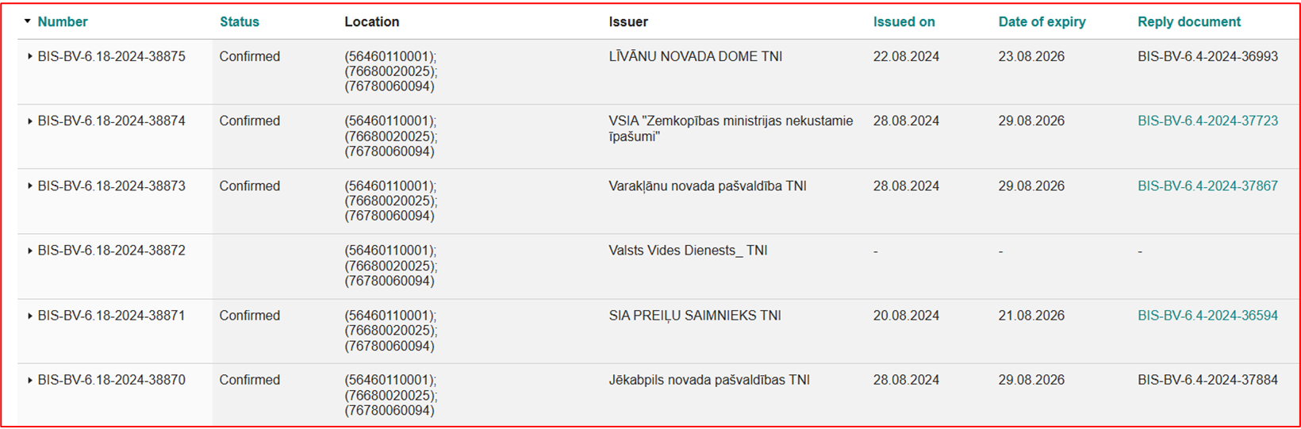
Construction file: Purva hidroloģiskā režīma stabilizēšana dabas liegumā “Lielais Pelečāres purvs” Building Information System (BIS) No.TMP-799794-248929 from 11.06.2024.
Technical specifications
*At the Nature Conservation Agency it is necesarry to obtain an opinion of the sertified species and habitat expert for mires, forests, heathland, vascular plants and bird species.

Slide 11
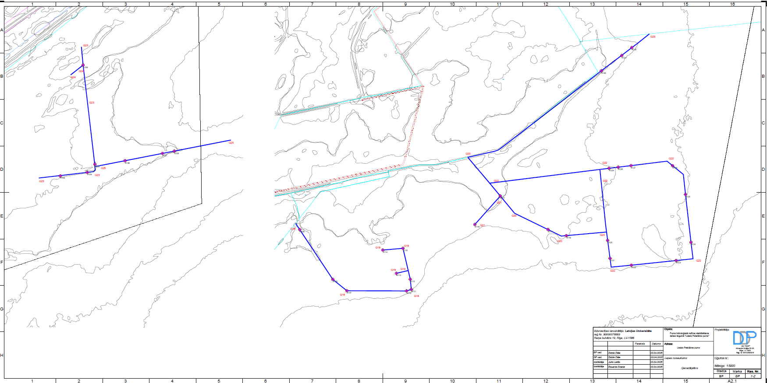
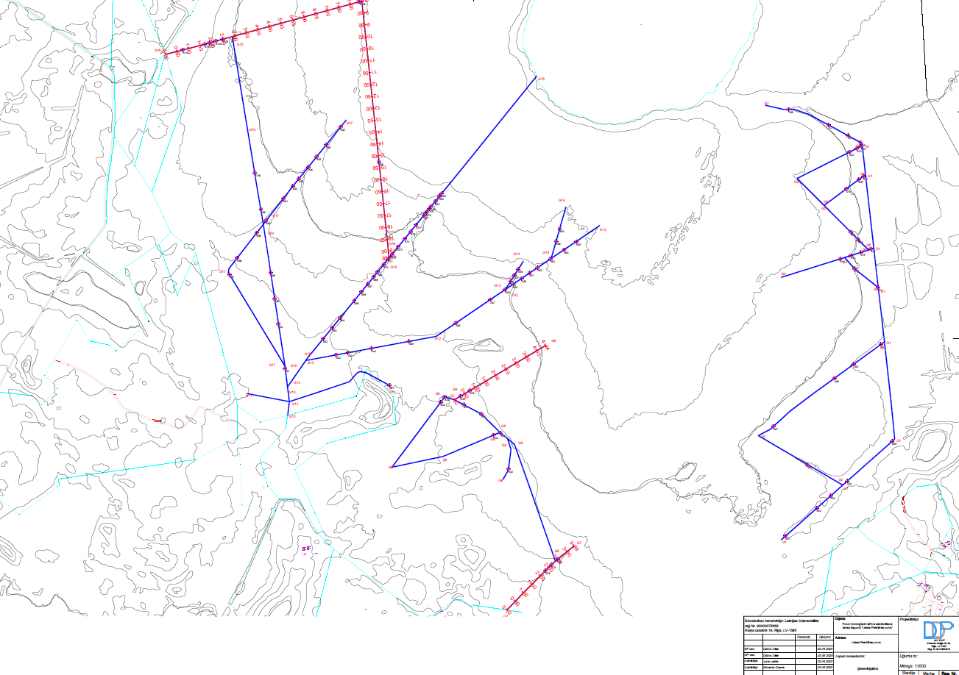
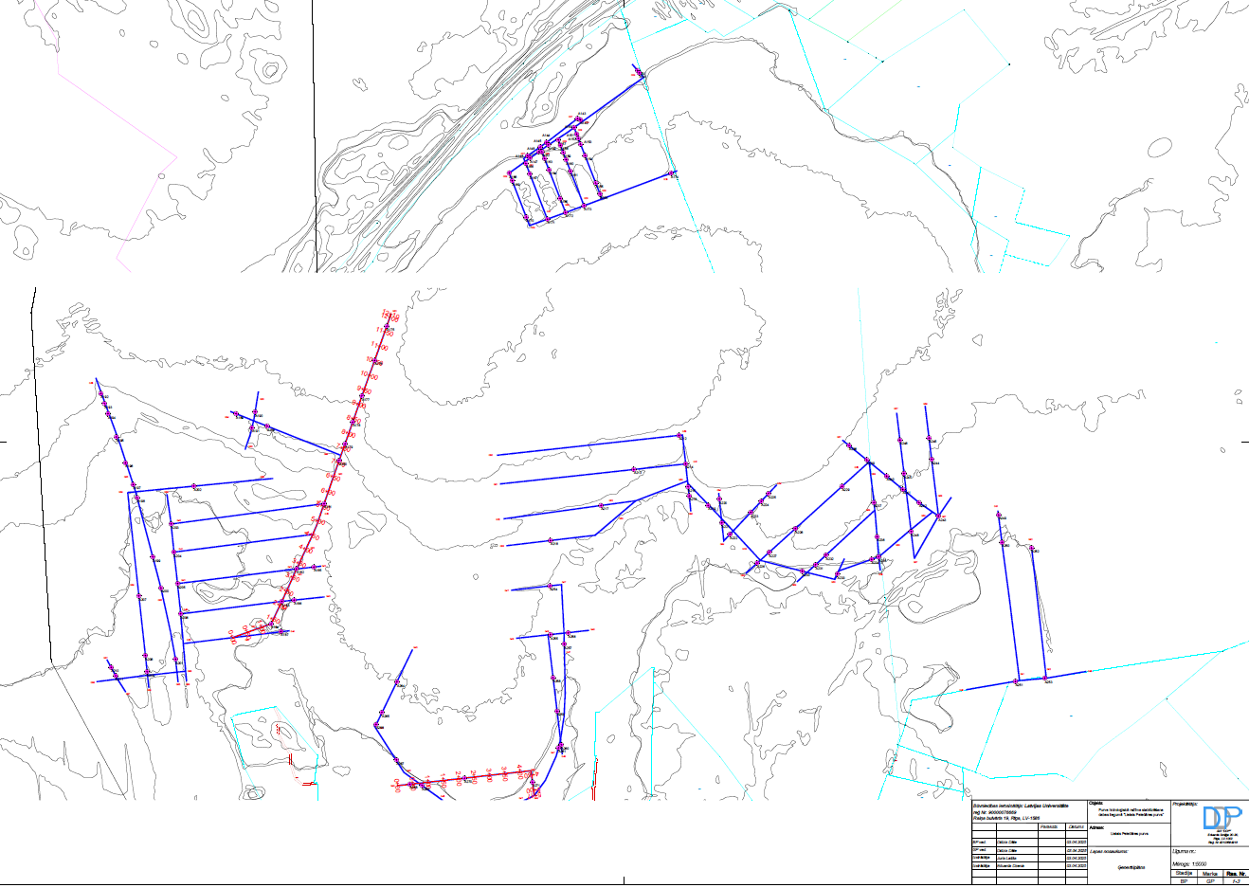
Draft of design project. System of ditches. Lielais Pelēčārēs purvs.

Slide 12
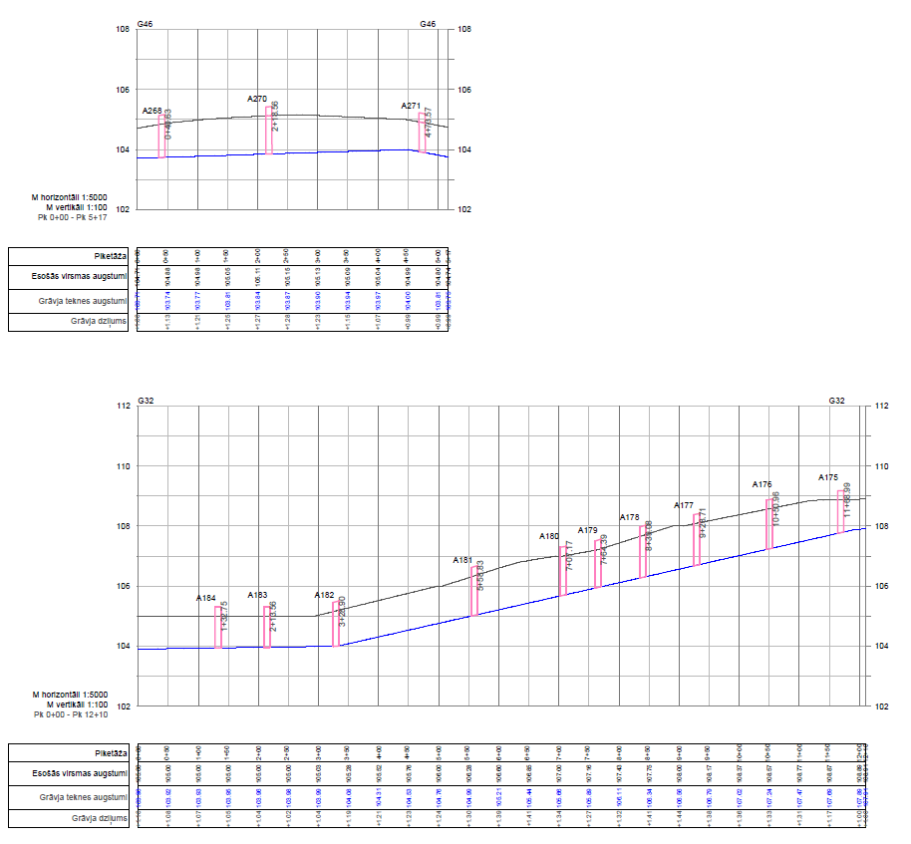
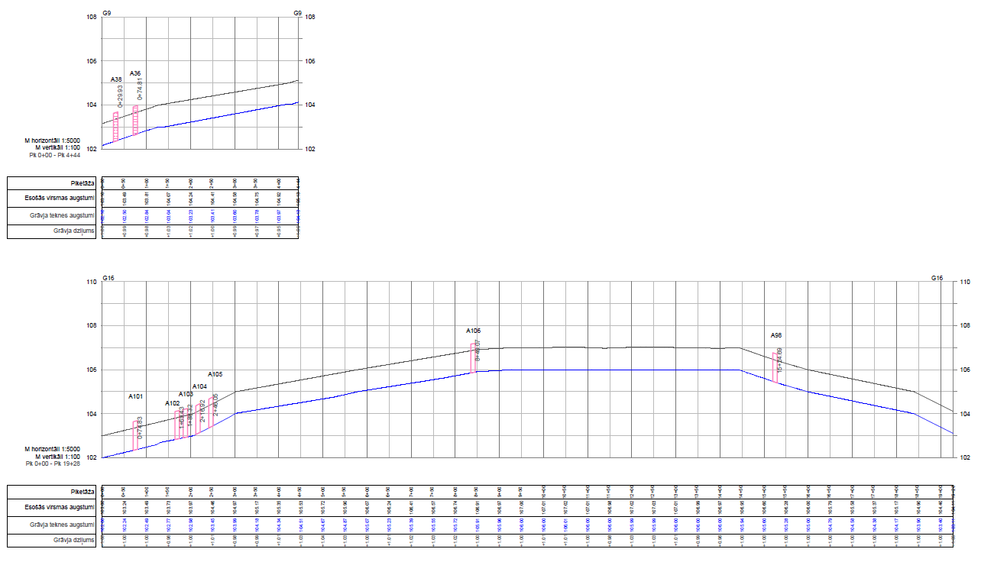
Draft of design project. System of ditches. Lielais Pelēčāres Mire.

Slide 13
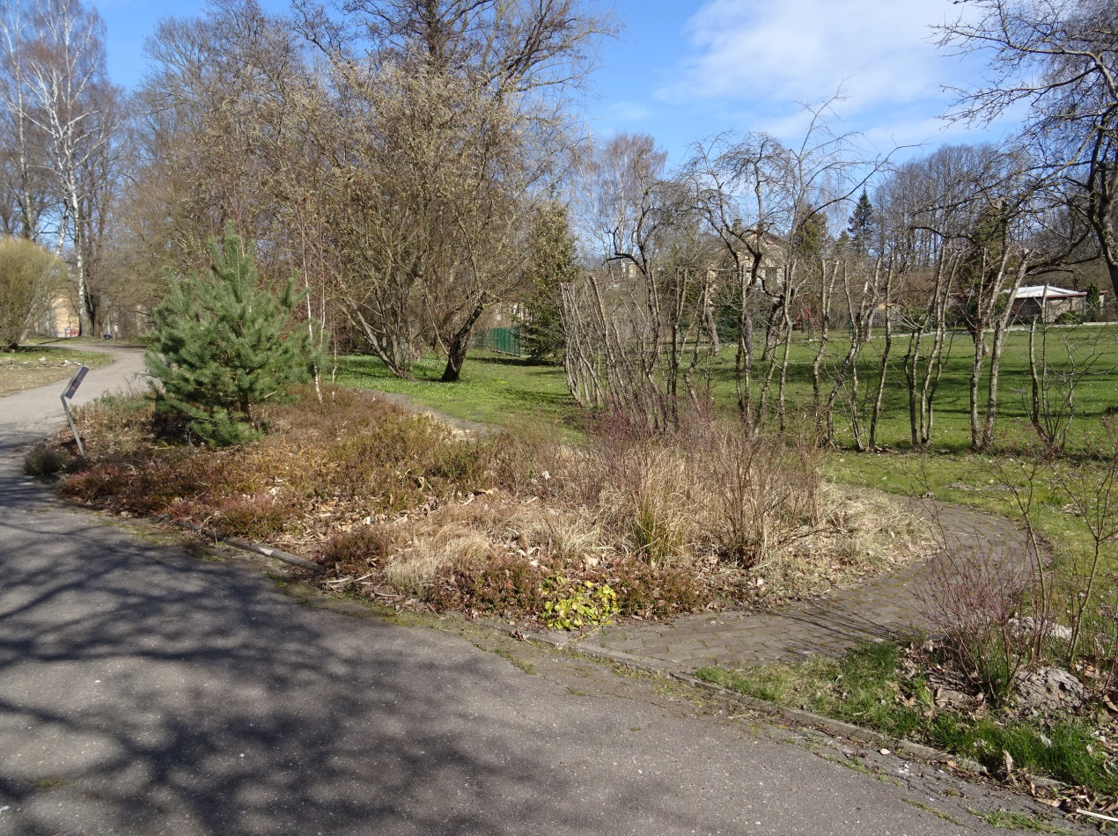
WP 5: Procurement «Peatland exposition in the Botanical Garden of University of Latvia» (Dizaina projekta izstrāde un tā izbūve «Purva ekspozīcijas izveide Latvijas Universitātes Botāniskajā dārzā»)
Regulation No. 104 «Regulations Regarding Procurement Procedure and Procedures for Application Thereof to Projects Financed by a Contracting Authority»;
Sent by email 29.08.2024., finished on 19.09.2024.;
Invited by SIA «My Work», agreement sign on 14.10.2024.;

Slide 14
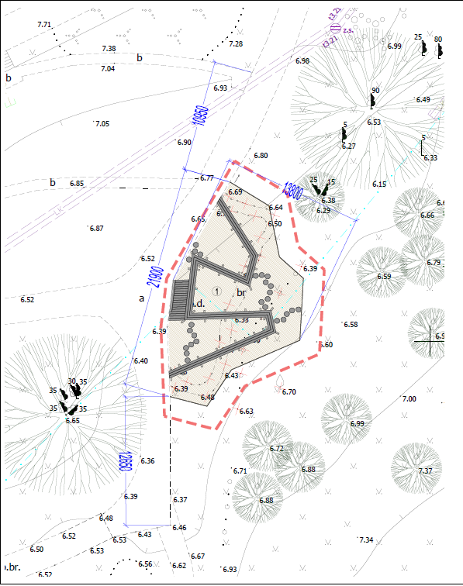
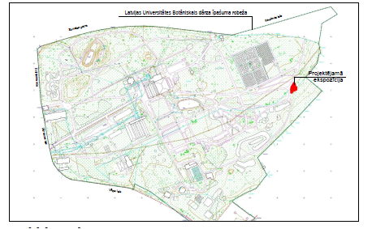
Location of exhibition
In general:
removed hedge – 16m;
excavation and removal of soil -200m²;
laying geotextile 250m²;
filled with peat 150m³;
wooden footbridge (finishing on spring 2025) 55m.

Slide 15
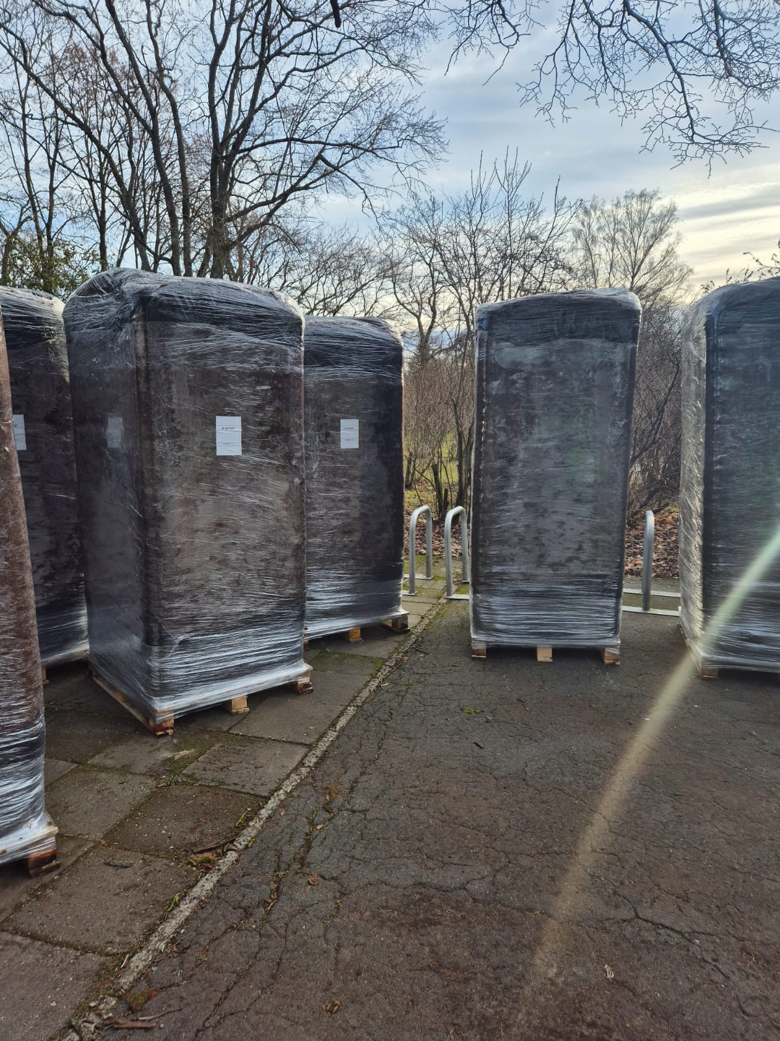
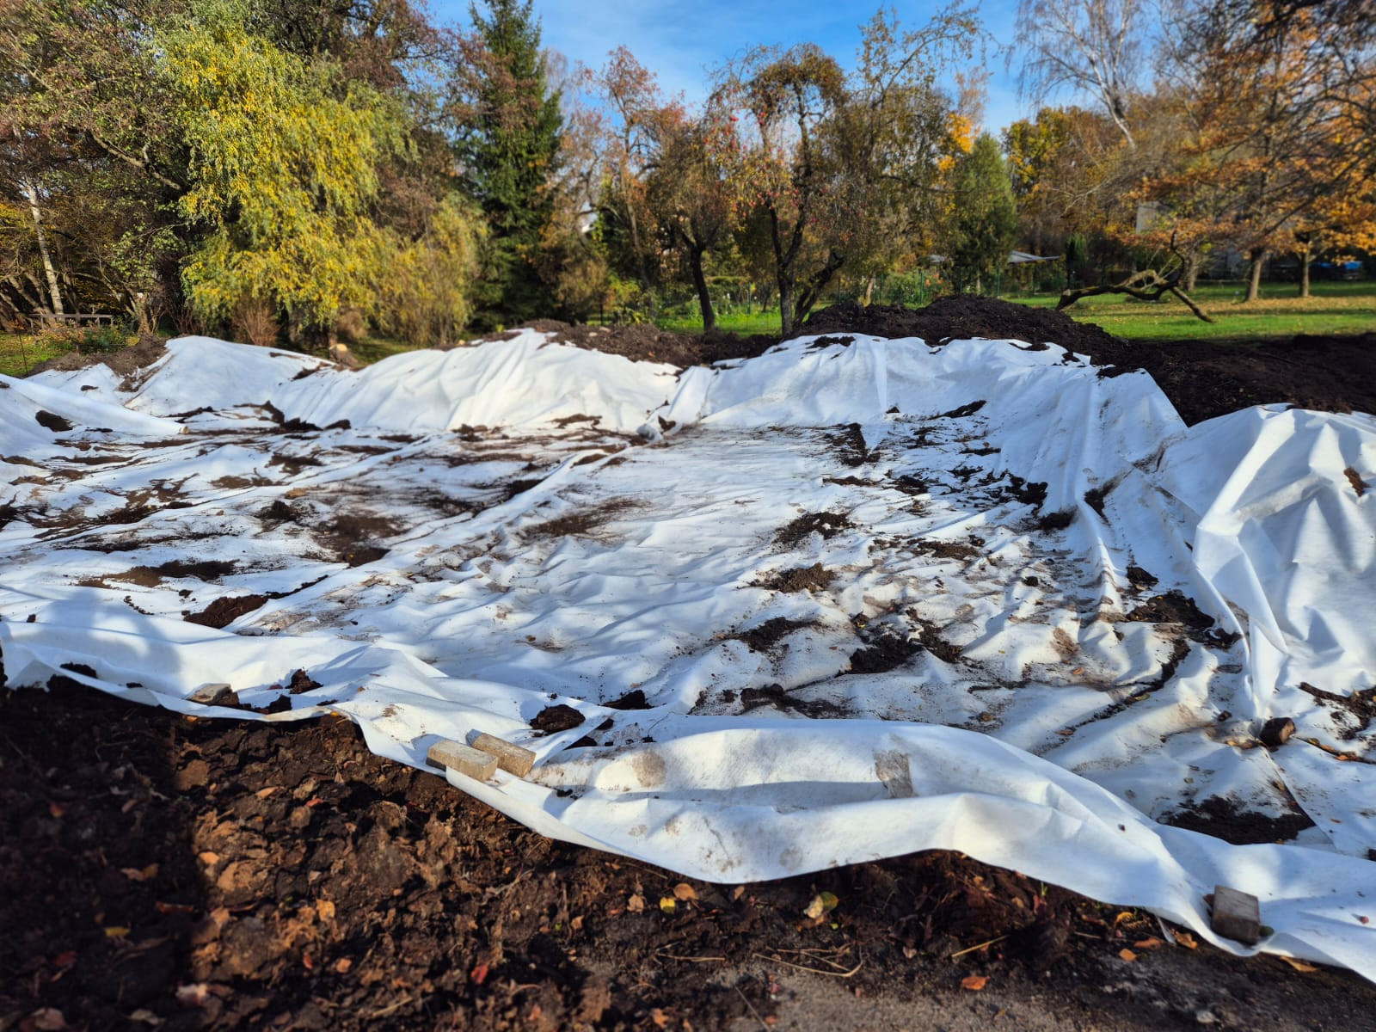

Slide 16
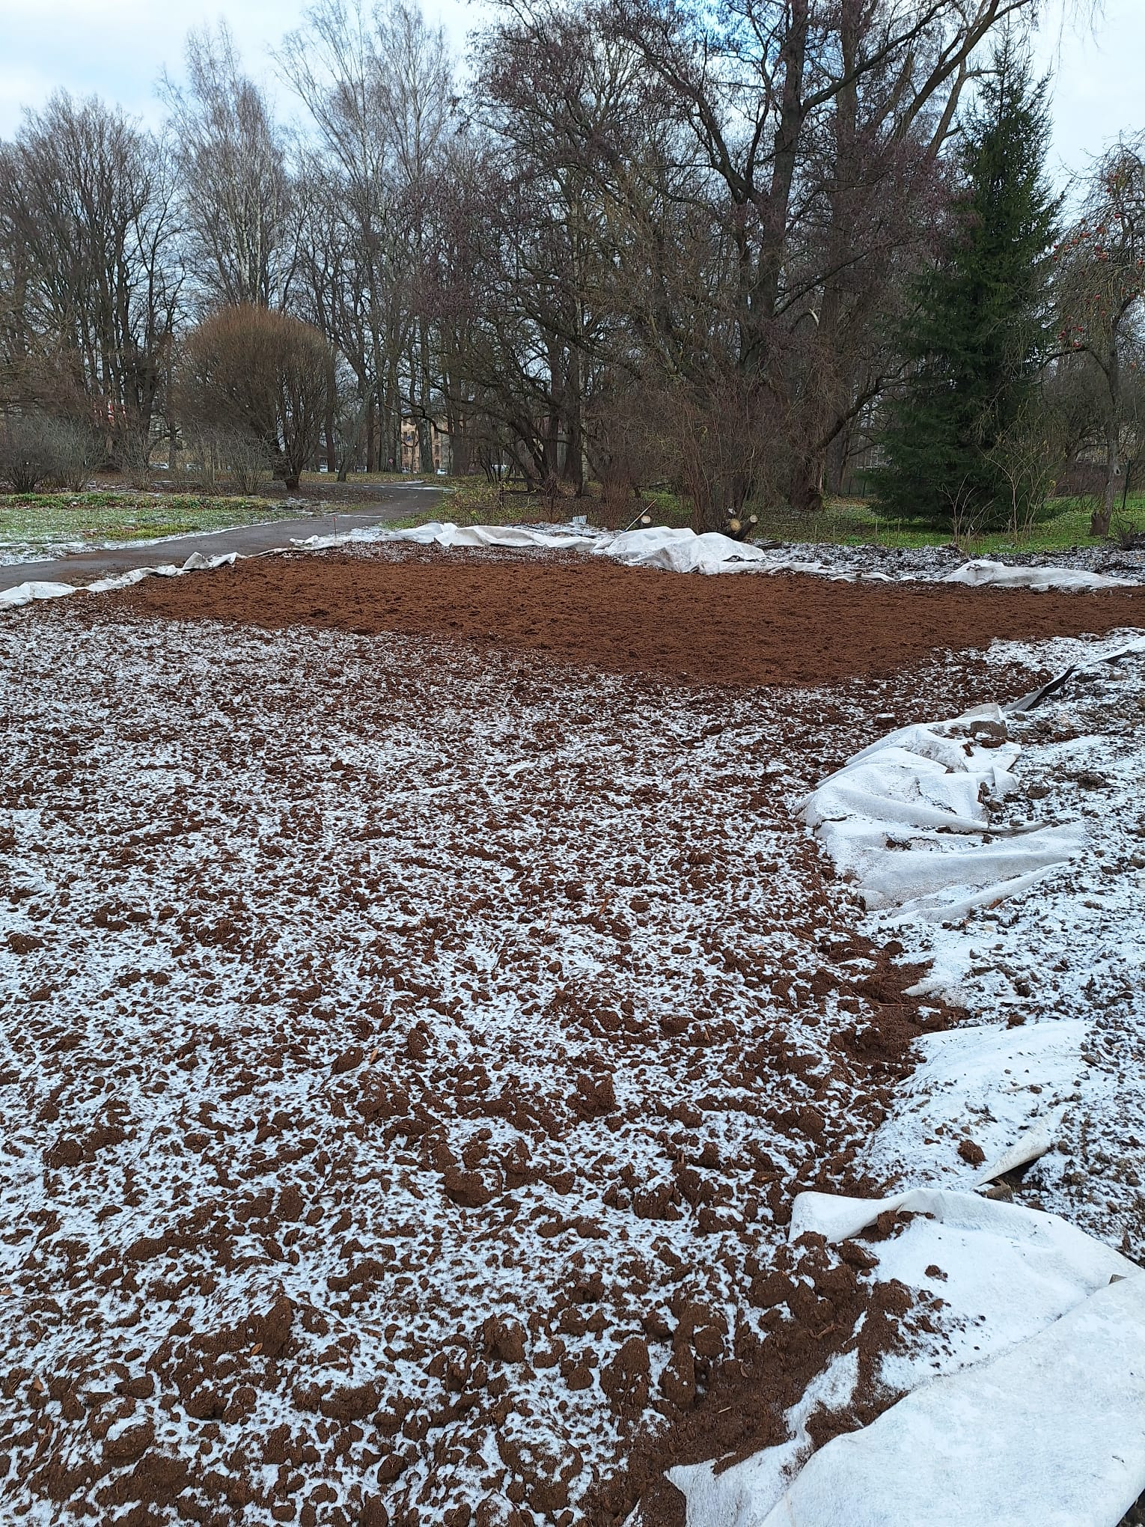
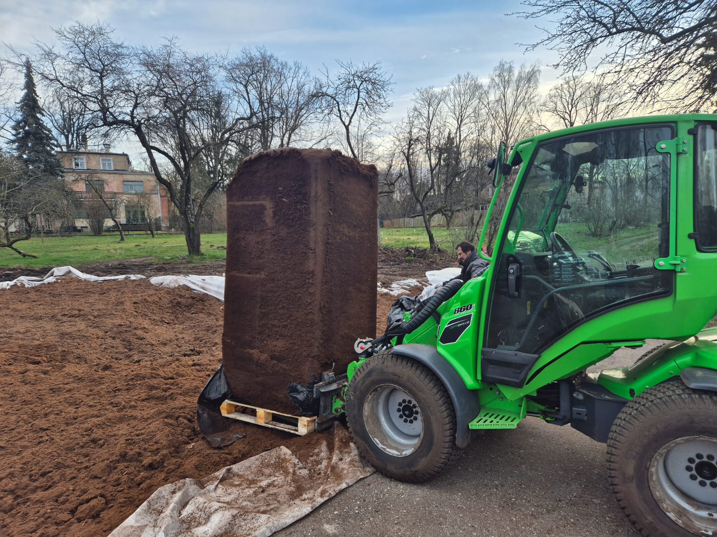

Slide 17
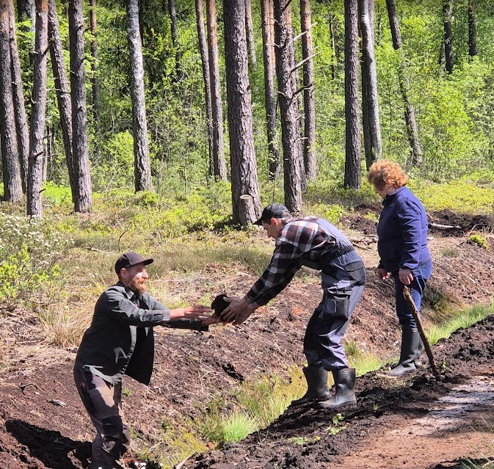
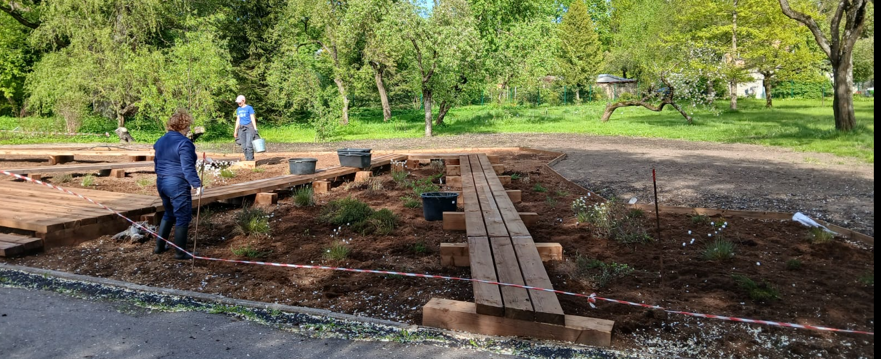
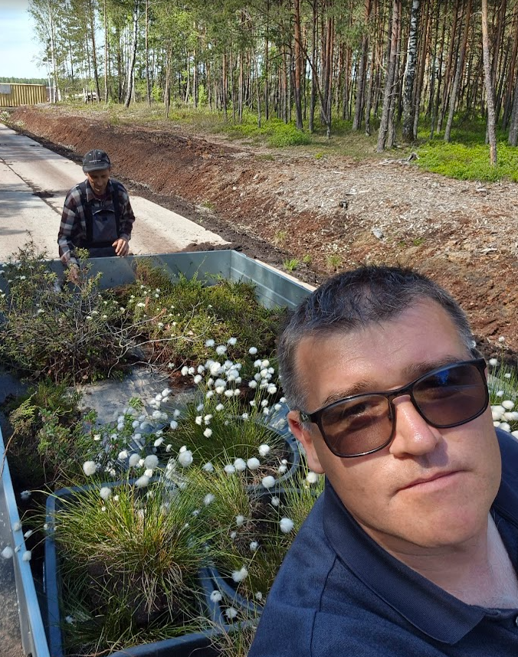
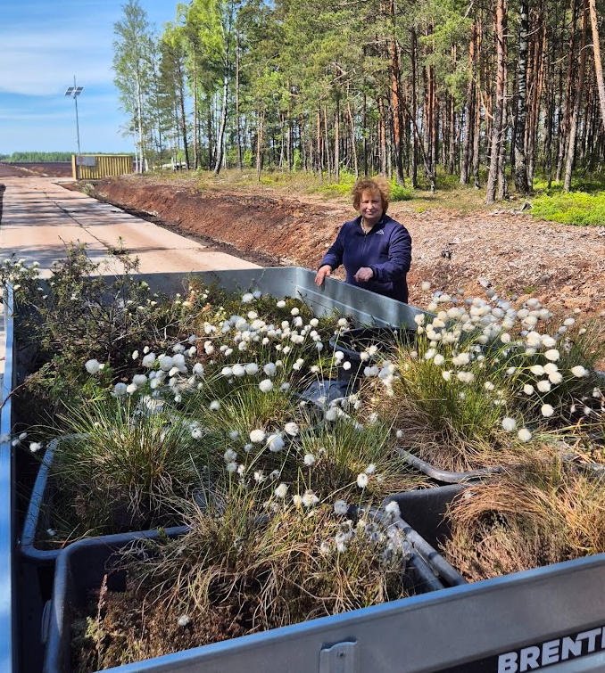
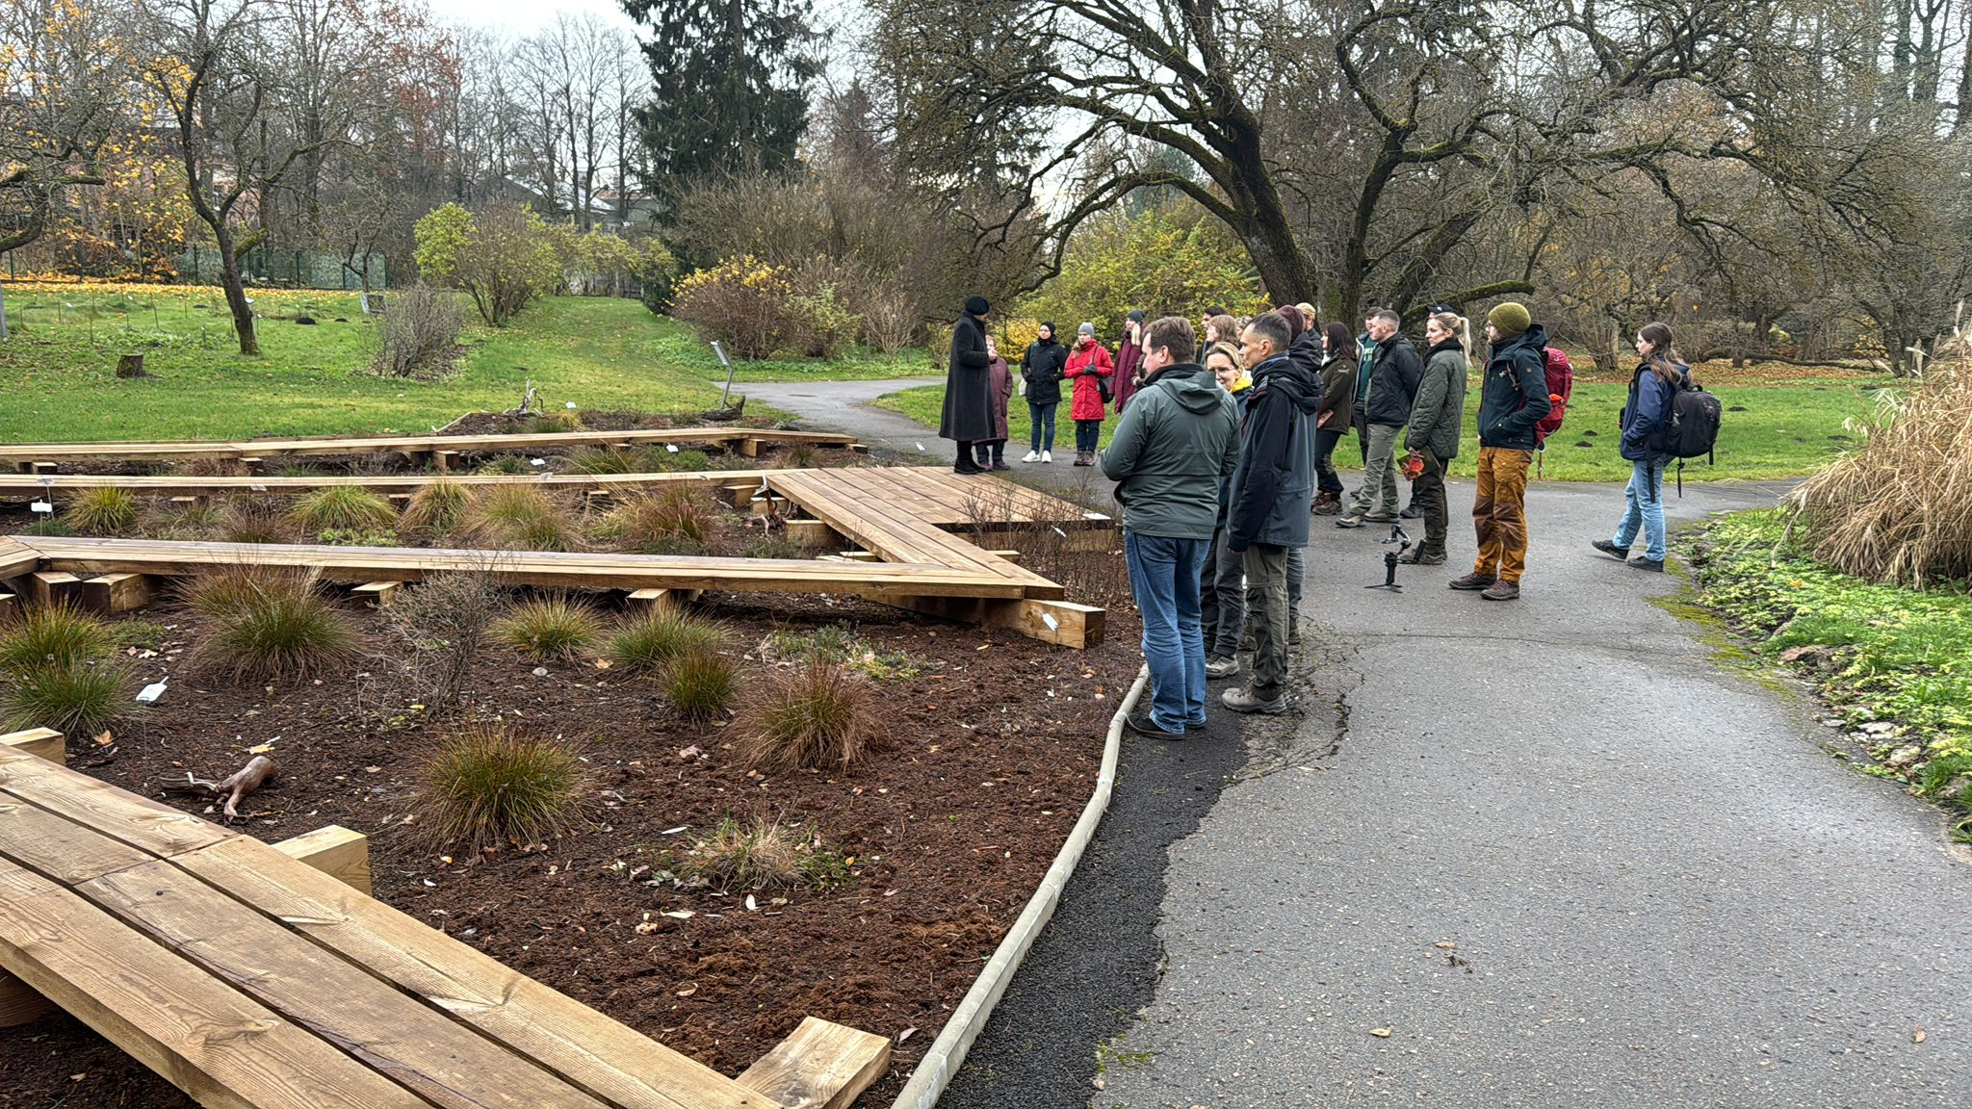

Slide 18
WP 2: Procurement «Building of dams for stabilizing the hydrological regime in the Nature reserves «Cenas Mire» and «Lielais Pelečāres Mire»» (Dambju būvniecība purva hidroloģiskā režīma stabilizēšanai dabas liegumos “Cenas tīrelis” un “Lielais Pelečāres purvs”)
The procurement was carried out in accordance with Regulation No. 104 of the Republic of Latvia (adopted on 28 February 2017), "Regulations Regarding Procurement Procedure and Procedures for Application Thereof to Projects Financed by a Contracting Authority".
Subject: Building of dams;
Publish on 07.09.2025.; finished on 29.09.2025. by Procurement Monitoring Bureau;
Invited by SIA «Būvuzņēmēju apvienība»; agreement sign on 24.10.2025..

Slide 19
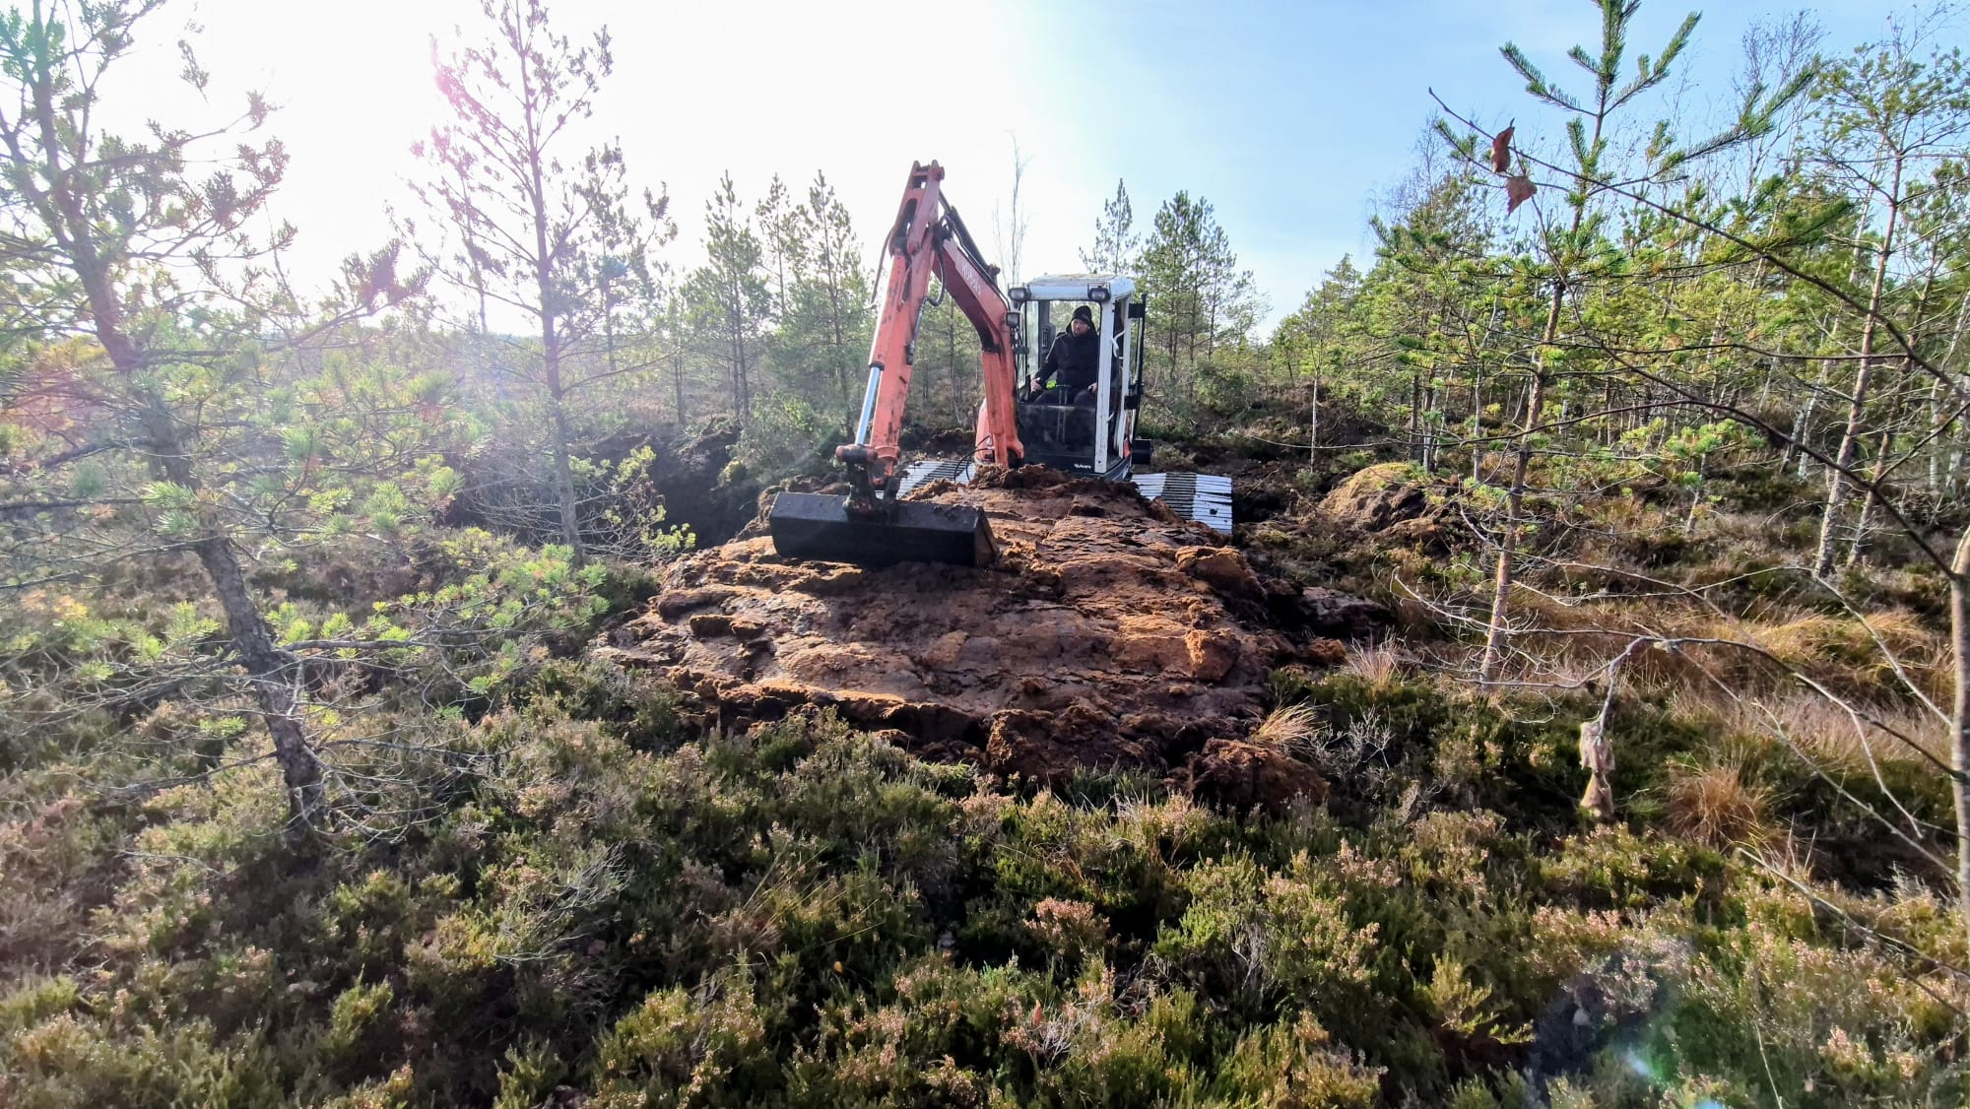
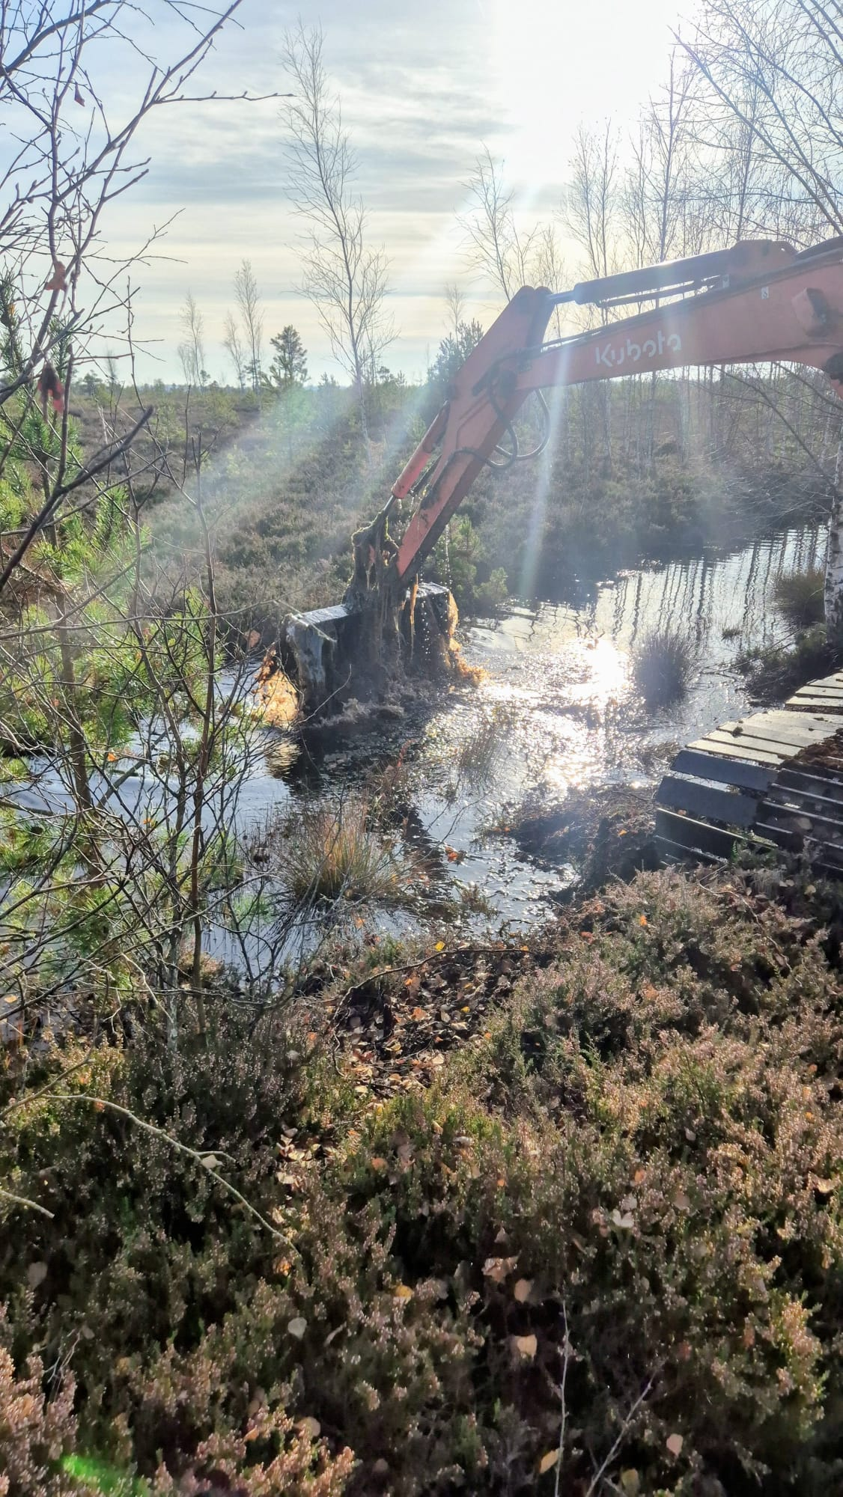
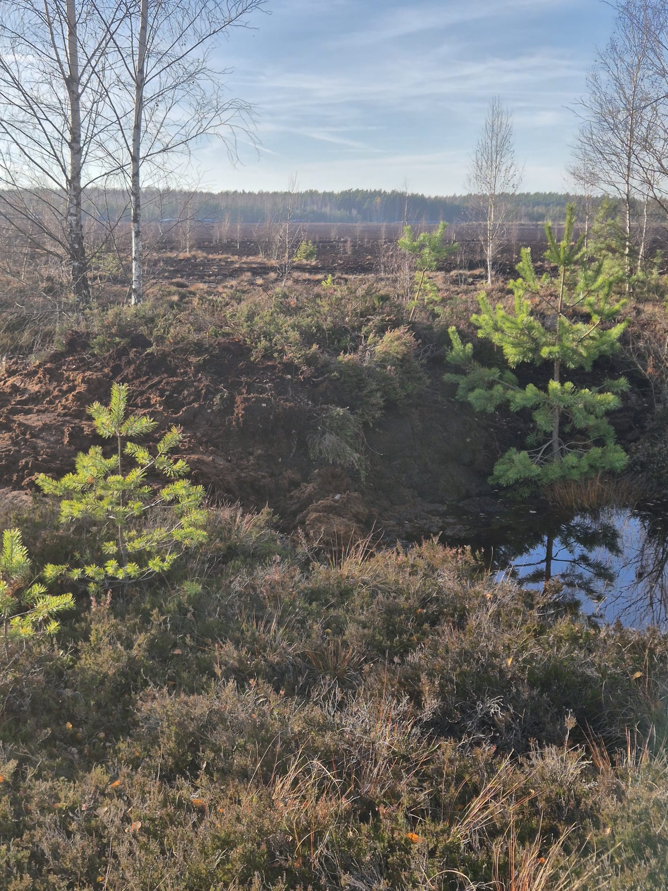
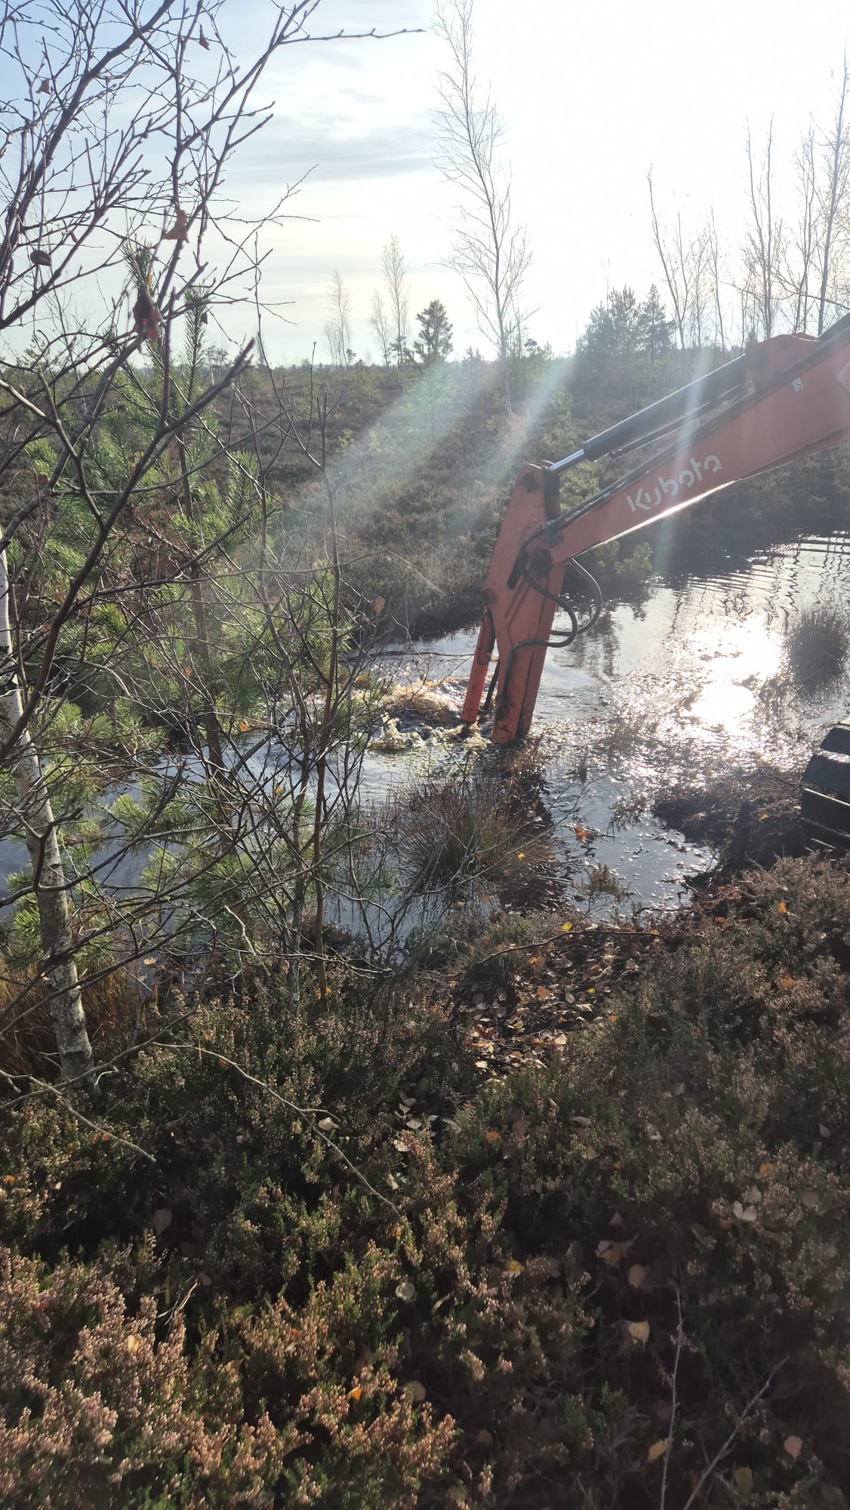
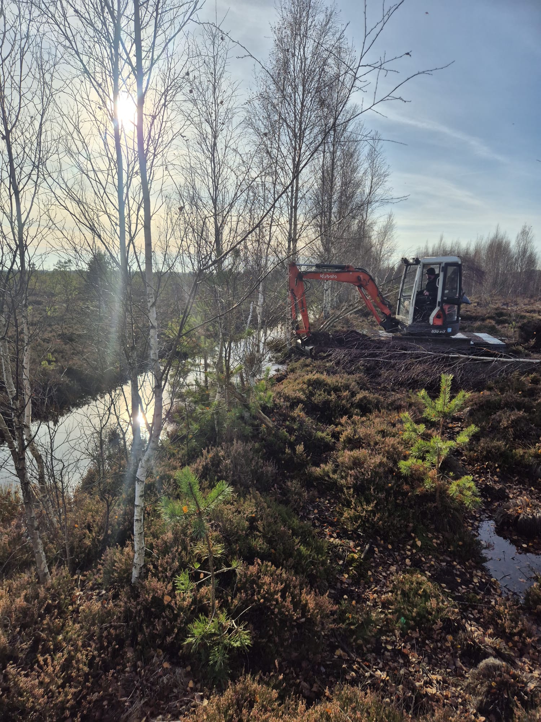

Slide 20
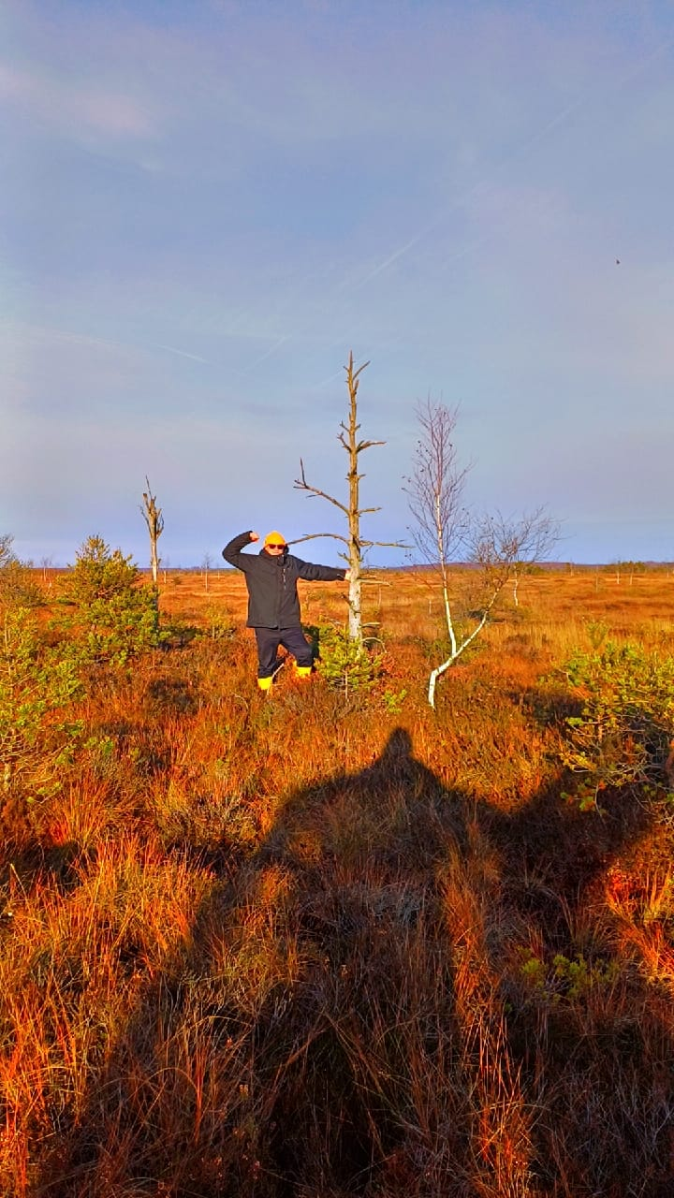
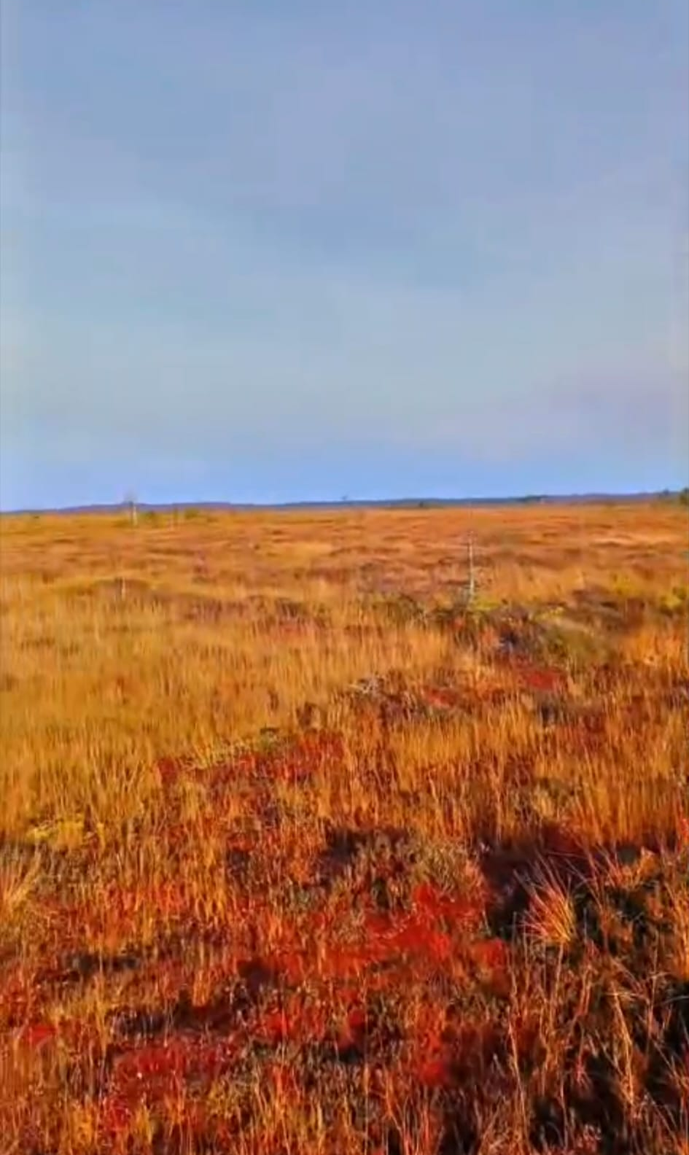
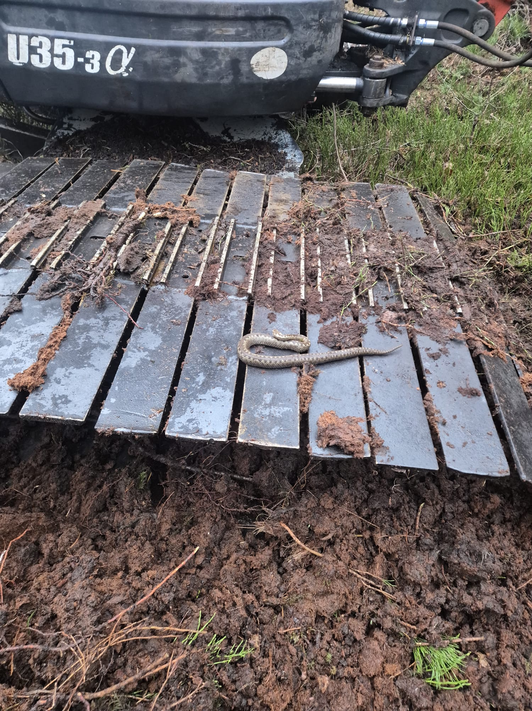
Rescue work: We woke it up, apologized, moved it to a safe place. See you in spring.

Slide 21
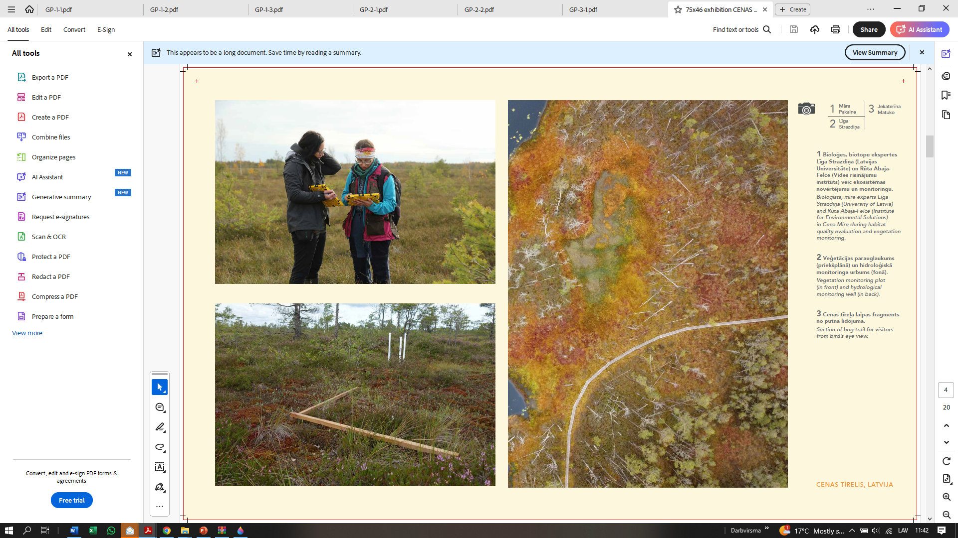
Next steps in 2025/2026:
Receive the dam building permits for Pelēčāre Mire;
Building work.

Slide 22
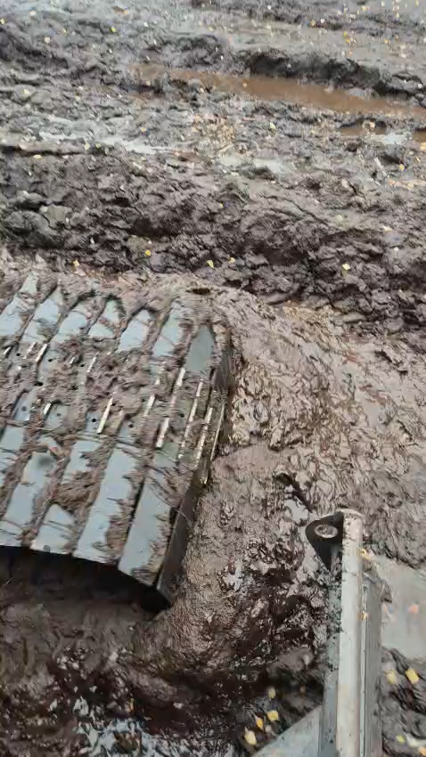
Thank you!

