Slide 1
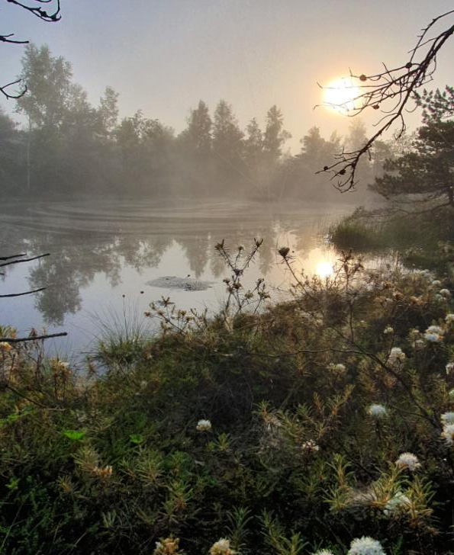
Dr. biol. Māra Pakalne
LIFE PeatCarbon project manager
University of Latvia
Kandavas Street 2, Rīga
LV 1063, Latvija
101074396 - LIFE21-CCM-LV-LIFE PeatCarbon project meeting 25/08/22
General information about the project
Project sites
Nearest tasks
Project hydrological studies
Financial questions
Partnership agreement
Information from the beneficiaries about the start of the project
Other questions
Dr. biol. Māra Pakalne
18/08/22

Slide 2
101074396 - LIFE21-CCM-LV-LIFE PeatCarbon
Peatland restoration for greenhouse gas emission reduction and carbon sequestration in the Baltic Sea region
Dr. biol.Māra Pakalne & Gunta Sirmā
University of Latvia
25/08/22

Slide 3
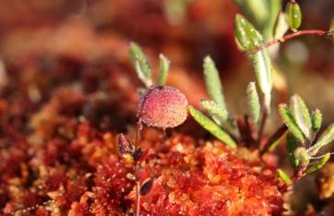
The process of project approval
29 Apr.
informative letter from EC about the project funding
4 May
questions from EC received
29 June
answers completed, including of the information in the project portal
19 July
agreed with EC that the start at of the project is July 1.
27 July
EC and University of Latvia signs the project application

Slide 4
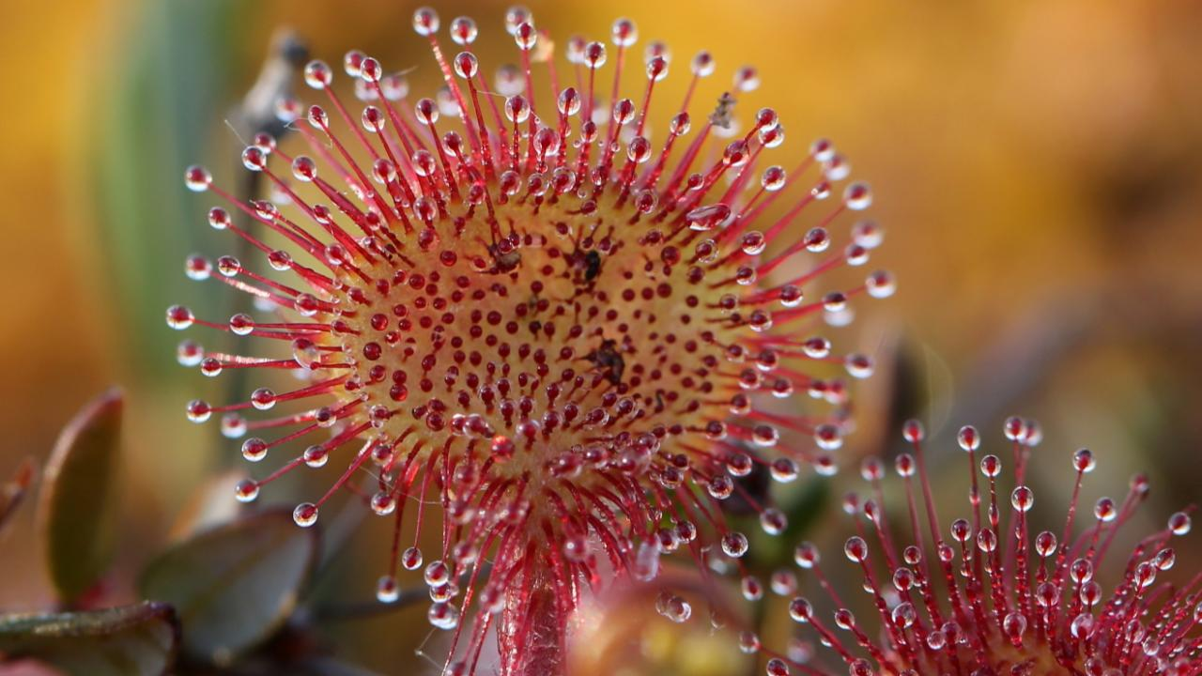
Project sites
101074396 - LIFE21-CCM-LV-LIFE PeatCarbon
Peatland restoration for greenhouse gas emission reduction and carbon sequestration in the Baltic Sea region

Slide 5
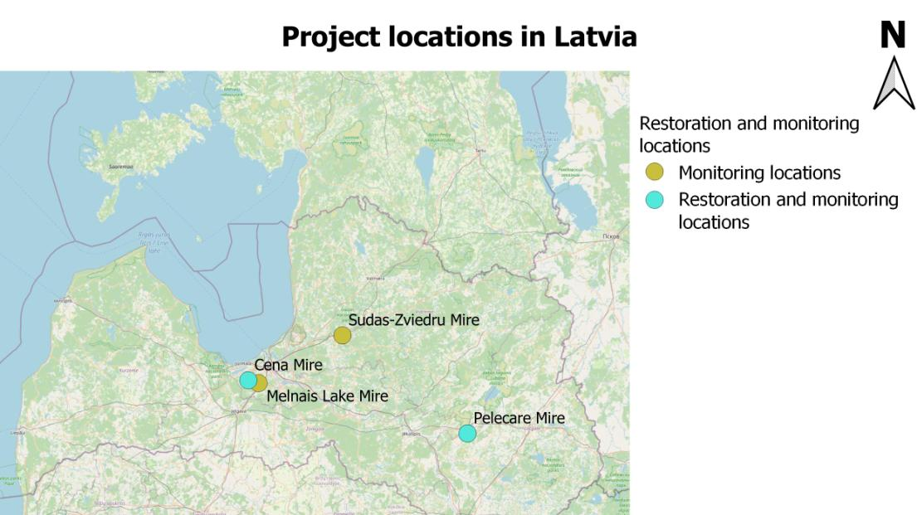

Slide 6
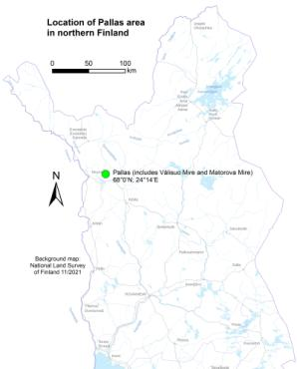
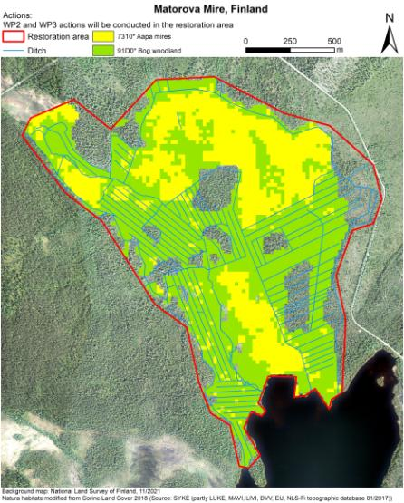
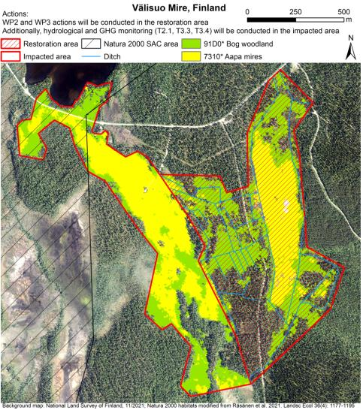
Project sites in Finland

Slide 7
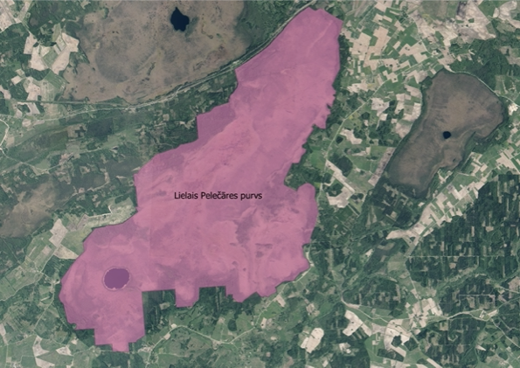
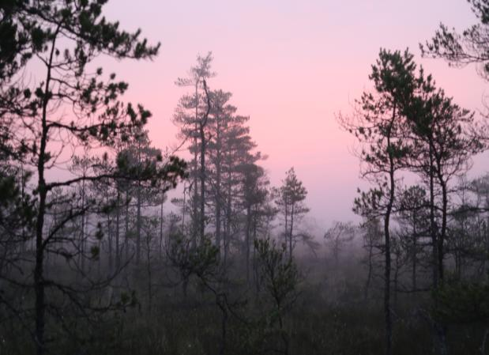
Lielais Pelečāre Mire

Slide 8
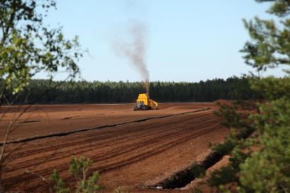
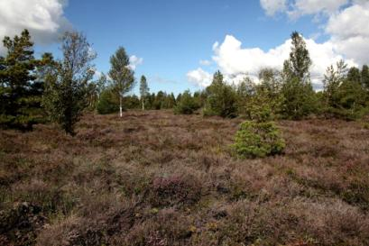
Cenas Mire and Melnais Lake Mire

Slide 9
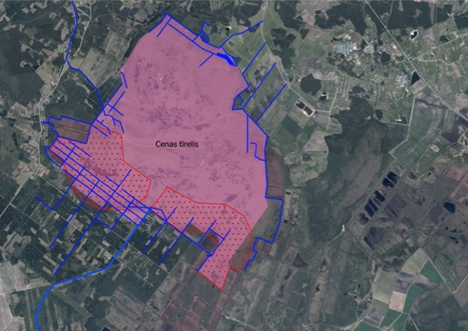
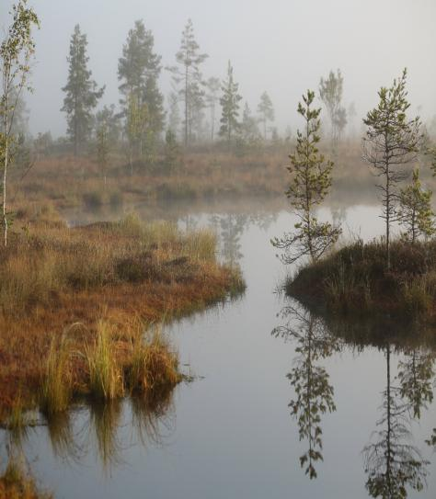
Cena Mire

Slide 10
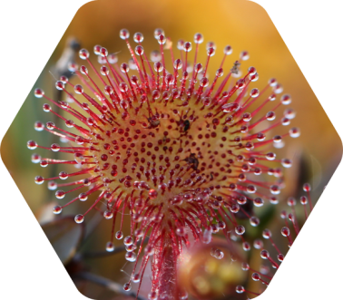
Project sites include active and degraded raised bog habitats

Slide 11
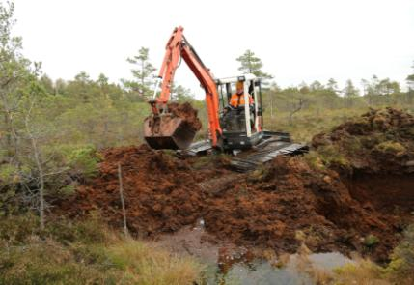
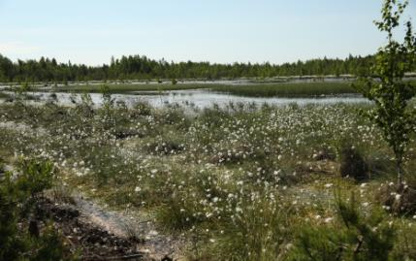
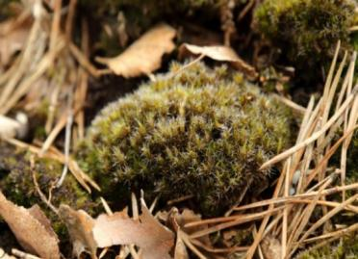
Melnais Lake Mire
In 2012 peat dams were built
Hydrological and vegetation studies started in 2010 will continued
New – GHG monitoring in 2023/2025
Invasive species
Campylopus introflexus​

Slide 12
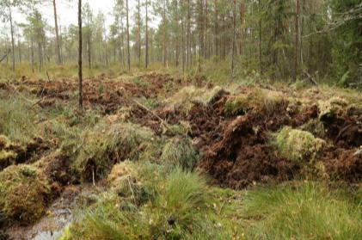
Sudas-Zviedru Mire in the Gauja National Parkā
In 2017 peat dams built on drainage ditches
In the LIFE PeatCarbon project hydrological and vegetation monitoring started in 2015 within LIFE
“Wetlands” project will be continued
New task LIFE PeatCarbon project – GHG monitoring
Monitoring will be carried out in 2023 / 2025
Remote sensing will be repeated, firstly 2018
In the new Management Plan for GNP, project tasks concerning monitoring are included

Slide 13
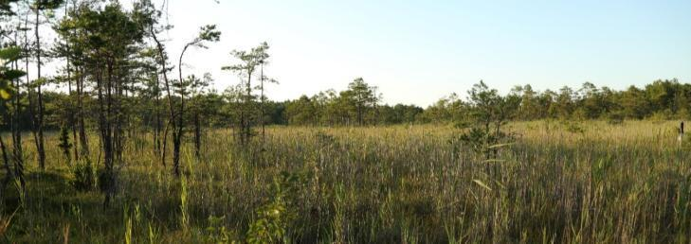
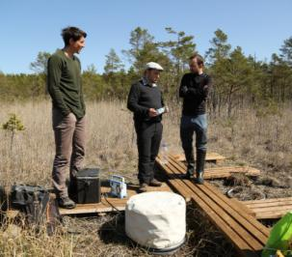
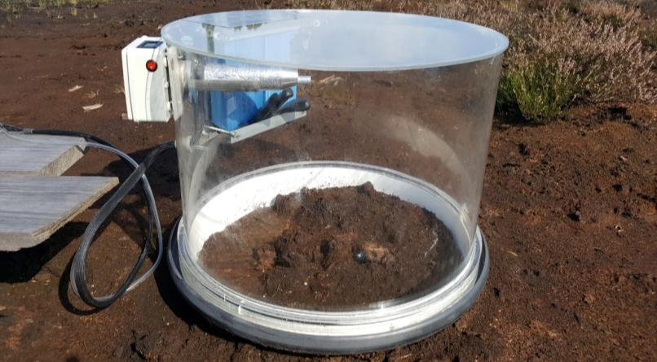
GHG measurements will be carried out by Forest Research institute «Silava»

Slide 14
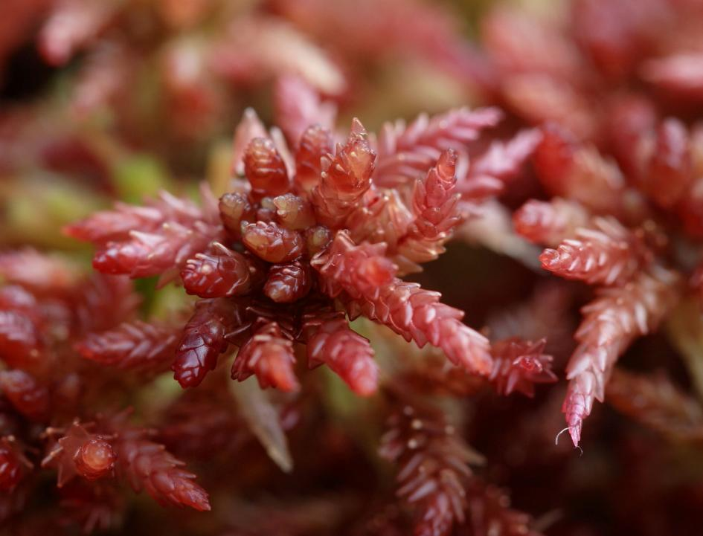
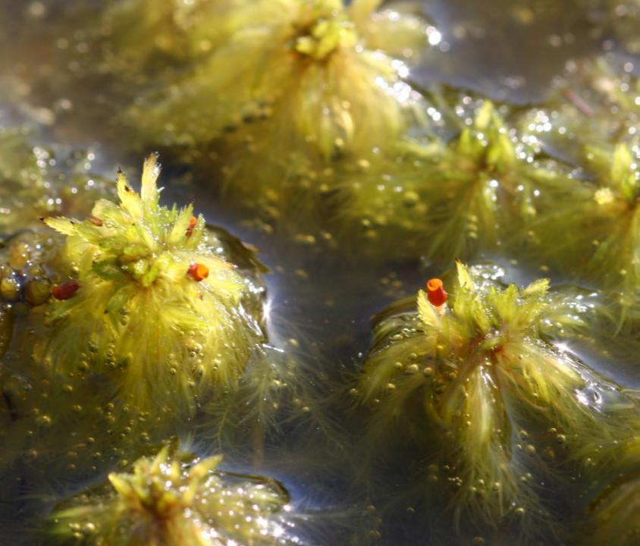

Slide 15
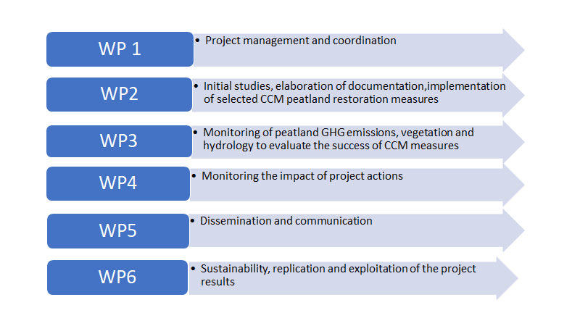
Project workpackages and tasks

Slide 16
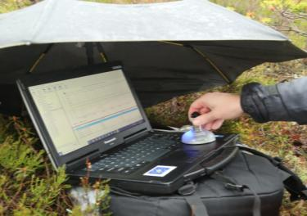
Project tasks
1. Completing and signing of partnership agreements
2. Establishment of the Project Team
3. Organising of project meetigs once per month (online)
4. Hydrological, geological studies in the project sites, establishment of hydro-geological models (LU, OULU)
4. Elaboration of technical designs (AGS)
5. Establishment of Peatland Restoration Plans (LU and LUKE)
6. Establishment of the project web page (LU and all beneficiaries)
7. New task – Environmental Impact Assessment as propaedeutic study before restoration (LU, AGS, LUKE)
8. Projekta kick-off meeting – second half of november – in Riga or online

Slide 17
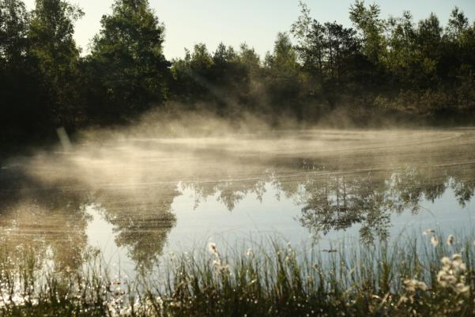
Project web page
Under the web page of the University of Latvia, Botanical Garden
https://www.botanika.lu.lv/lv/projekti/life/
All beneficiaries will be required to place information about the project at the web pages of their organisations, as well as about the progress of their tasks
The structure will be similar to the one for LIFE Peat Restore project
https://life-peat-restore.eu/en/

Slide 18
Time schedule
1. ESSENTIAL ELIGIBILITY POINTS

Slide 19
Time schedule
Time schedule

Slide 20
Time schedule

Slide 21
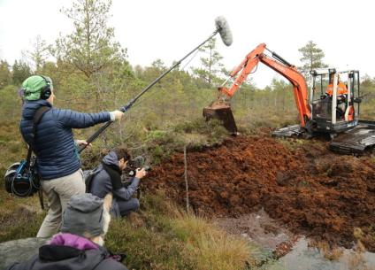
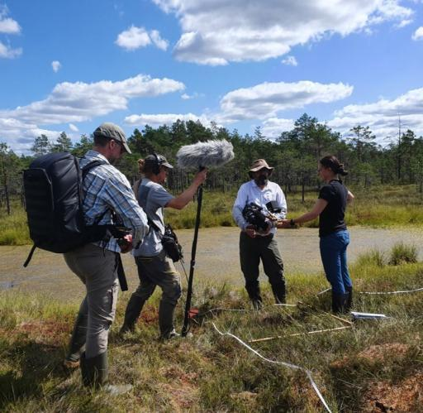
Public awareness

Slide 22
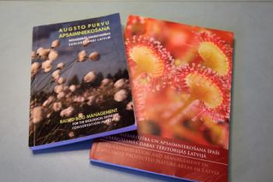
Important deliverables
Best Practice book
Photo Book
Photo exhibition
Articles on the project results

Slide 23
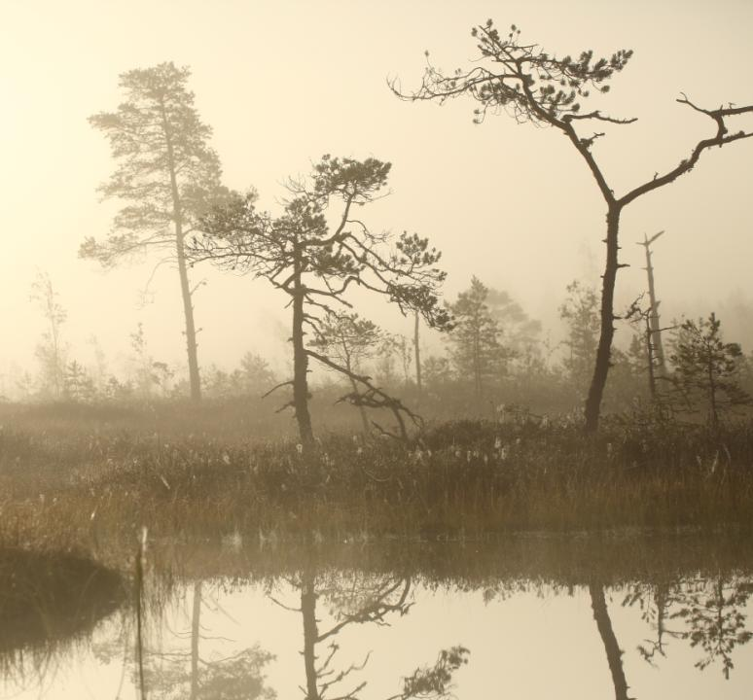
FINANCIAL ASPECTS
ESSENTIAL ELIGIBILITY POINTS
PAYMENTS – EU CONTRIBUTION PART
REPORTING on action PROGRESS and TIMESHEETS
TECHNICAL REPORTS and FINANCIAL STATEMENT

Slide 24
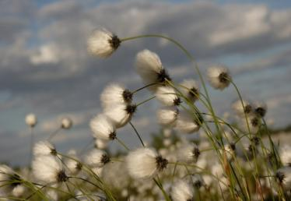
1. ESSENTIAL ELIGIBILITY POINTS
Terms and conditions – is part of Grant Agreement
Binding on all partners and must be observed during project implementation
Incl. Visibility rules (Article 17 of Terms and conditions), public procurement rules (EU directives and applicable national law on public procurement)
In all documents (contracts, orders, invoices, etc.) reference to the project number and acronym:
101074396 — LIFE21-CCM-LV-LIFE PeatCarbon
Separate code for project expenditures
All project expenditures should be separate from other partner expenditures with a separate code in the project partner's accounting (bookkeeping) system
Implementing the project activities according to the project and budget
Any changes - contact to LU before dessicion
Budget flexibility - Article 5.5. of Terms and conditions
No flexibility caps for our project, no restriction - as long as this does not imply any substantive/ important change to the description of the action

Slide 25
2. PAYMENTS – EU CONTRIBUTION PART
Prefinancing payment
Max. 30% of total EU contribution to eligible costs
After signing of Partnership Agreement and Invoice submission to LU
Additional prefinancing payment
Max. 50% of total EU contribution to eligible costs
After additional prefinancing report submission to EC (CINEA) (if 70% of prefinancing payment spent) and approval
Final payment
Max. 20% of total EU contribution to eligible costs
After FINAL report submission to EC (CINEA)

Slide 26
3. REPORTING on ACTION PROGRESS and TIMESHEETS
Template created – sent to all partners on 23/08/2022
2 parts
Timesheet
Report (Description of main tasks, achieved results)
LU as Coordinating beneficiary should follow the project progress, all action to ensure appropriate project implementation
All partners (1 person from each partner about all project staff) send timesheets to LU until 10th date of next month for the previous month to:
mara.pakalne@lu.lv (Project manager);
peteris.abolins@lu.lv (National coordinator);
gunta.sirma@lu.lv (Project financial manager)

Slide 27
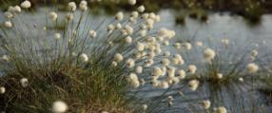
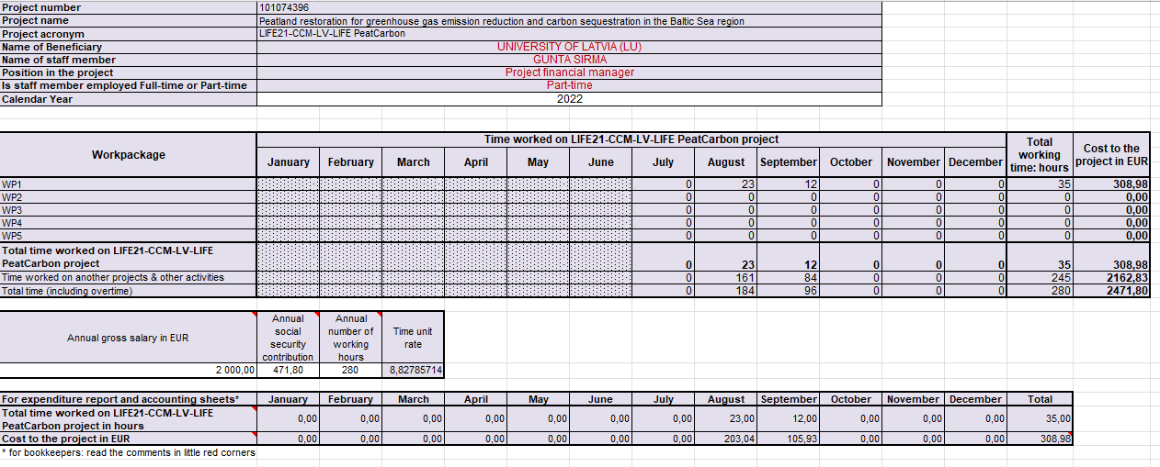
3. REPORTING on ACTION PROGRESS and TIMESHEETS
TIMESHEETS

Slide 28
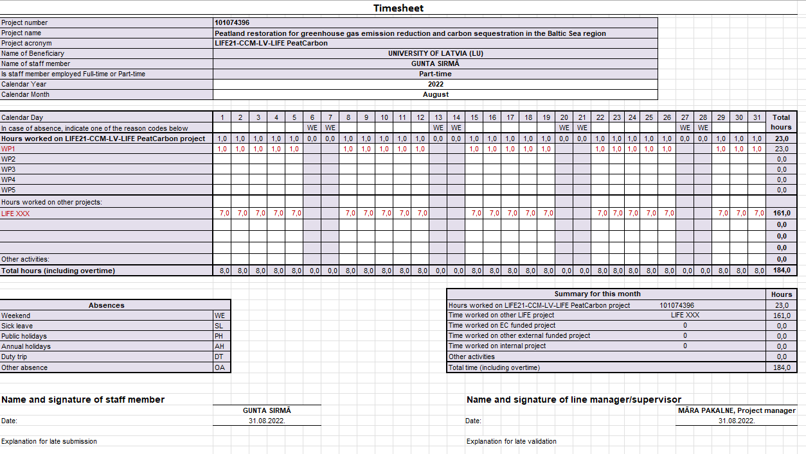
3. REPORTING on ACTION PROGRESS and TIMESHEETS

Slide 29
3. REPORTING on ACTION PROGRESS and TIMESHEETS
IMPORTANT! Project eligible direct Personnel costs must be calculated according to the Terms and conditions (Article 6.2., part A.1.).
Personnel costs must be calculated with the following method:
The total number of day for a person for a year, cannot be higher than 215 (or 215 x 8 = 1720 hours)

Slide 30
4. TECHNICAL REPORTS and FINANCIAL STATEMENTS
Article 21 of Terms and conditions
2 reports during project implementation
Additional prefinancing report (1 – 30 month / 01/07/2022-31/12/2024)
Periodic report (FINAL report) (31 – 60 month / 01/01/2025-30/06/2027)
Each report - 2 parts: Technical part and Financial part
Submission via PORTAL (https://ec.europa.eu/info/funding-tenders/opportunities/portal/screen/myarea/projects)
Templates – general
Financial part includes – detailed financial statement (no templates yet available)
More clear information – when we will have Financial monitoring expert of CINEA for our project and after KICK-OFF meeting from CINEA side
Regular reporting from all partners to UL will be required – each 6 months via management web application for administration and control of project costs – Project electronic monitoring system
Uploading documents, including timesheets, possibility approve the timesheets in the project electronic monitoring system

Slide 31
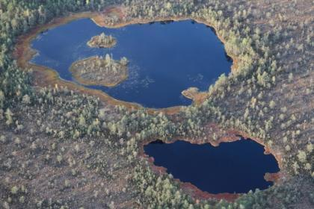
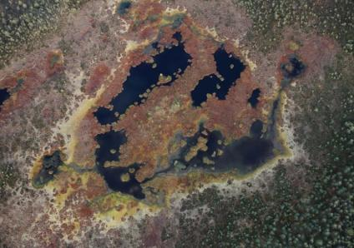
LIFE PeatCarbon project next meeting
From October 4-7, 2022.
What is your availability?
Sudas-Zviedu Mire from air – raised bog with bog pools

Slide 32
