Slide 1
Best Practice Book for Peatland Restoration
Dr. Māra Pakalne,
Email: mara.pakalne@lu.lv
University of Latvia

Slide 2
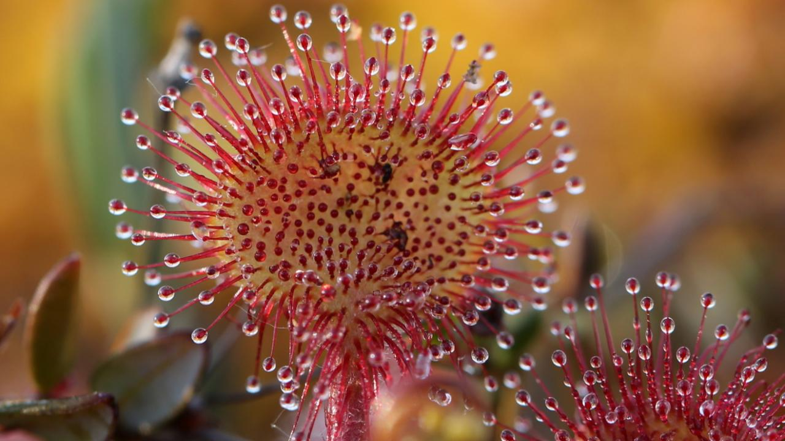
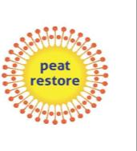
«Reduction of CO2 emissions by restoring degraded peatlands in Northern European Lowland» (2016-2022)
LIFE «PEAT RESTORE» LIFE 15 CCM/DE/000138
Challenges and experience gained

Slide 3
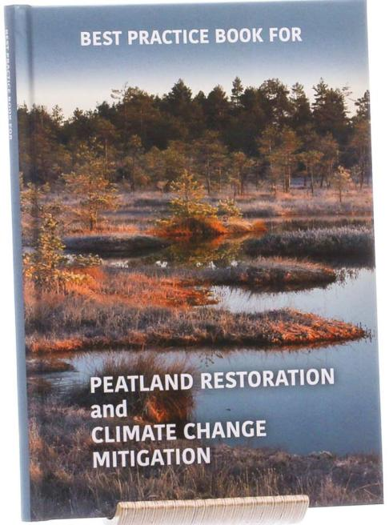
Book available on the web page of LIFE Peat Restore web page
https://www.mediafire.com/file/04cne8hcqm7byh3/22.11.21_WEB_LARGE_Peatland_restoration.pdf/file

Slide 4
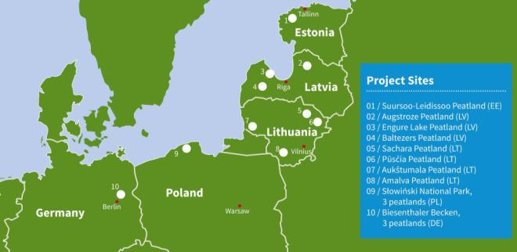
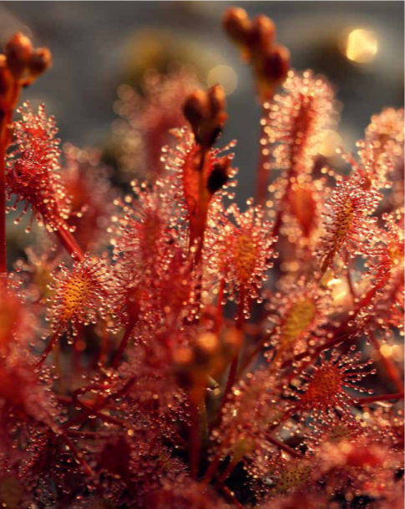
Contents
Glossary
Abbreviations
Overview of the project sites
Peatland restoration
Monitoring of peatland restoration success
Peatland restoration sites
Conclusions
Recommendations
References

Slide 5
General information about the LIFE Peat Restore project sites
Project sites (mostly within Natura 2000 sites) | Project area (ha) | Management area (ha)
Suursoo-Leidissoo peatland (EST) | 3 343 | 3 343
Augstroze peatland (LV) | 1 880 | 95
Engure Lake peatland (LV) | 106 | 106
Baltezers peatland (LV) | 228 | 41.6
Sachara peatland (LT) | 82.1 | 82.1
Pūsčia peatland (LT) | 80.7 | 80.7
Aukštumala peatland (LT) | 10 | 10.0
Amalva peatland (LT) | 215 | 215.0
Słowiński National Park: Kluki, Ciemińskie Błota, Wielkie Bagno peatlands (PL) | 1310 | 808.0
Biesenthaler Becken (DE), three peatlands | 15.5 | 15.5

Slide 6
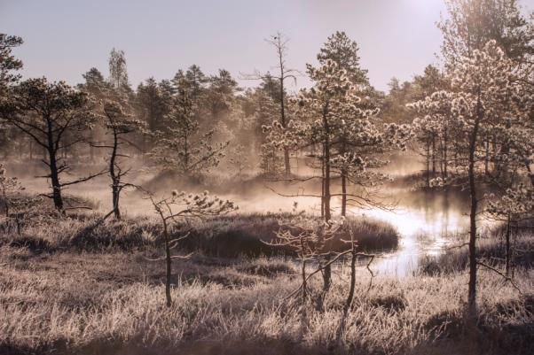
Challenges for peatland restoration in the project countries – Latvia, Estonia, Lithuania, Germany and Poland
Different ecosystems / mire types
Different situations for peatland restoration
Different traditions and experience of work

Slide 7
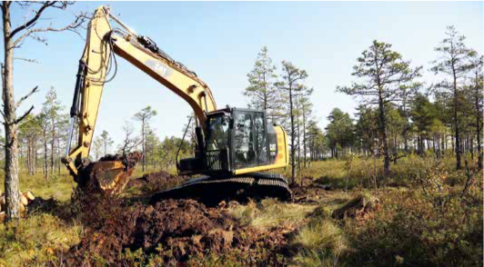
Peatland restoration techniques

Slide 8
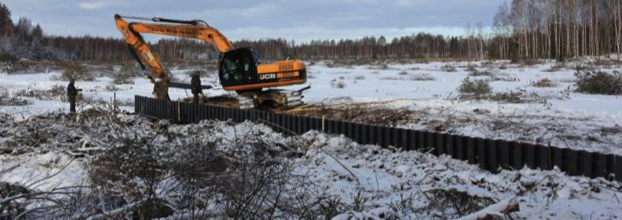
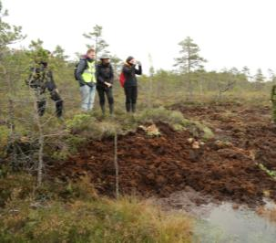
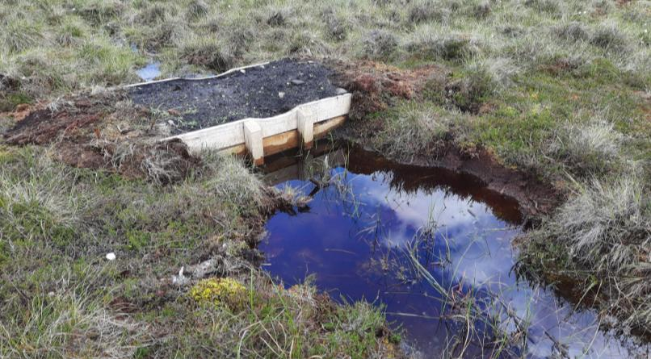
Types of dams in the project coutries

Slide 9
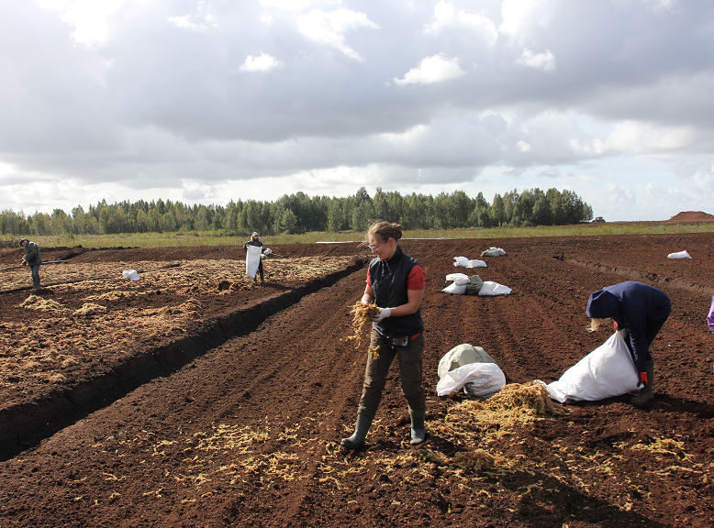
Reintroduction of Sphagnum species in Lithuania

Slide 10
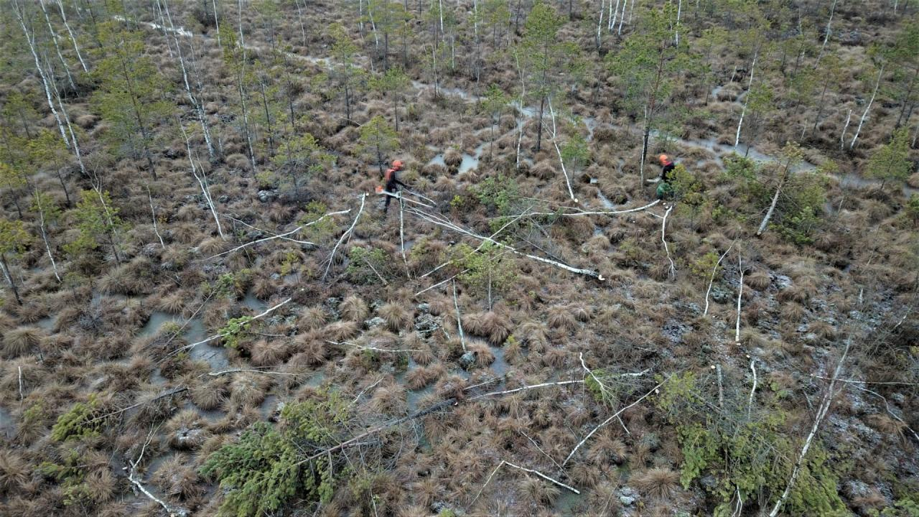
Removal of trees

Slide 11
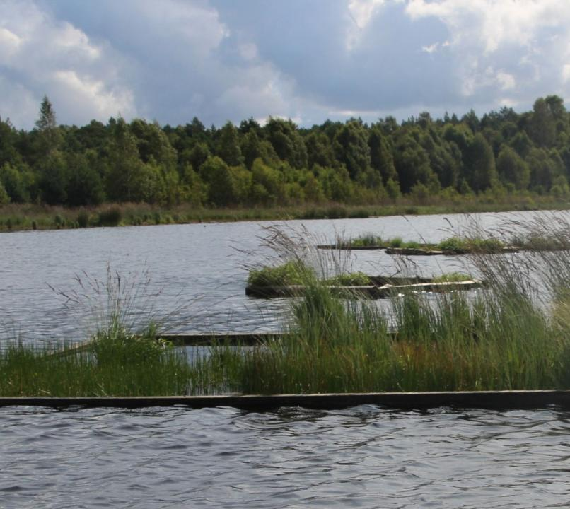
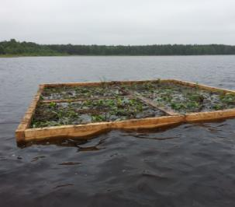
Establishment of floating islands in Poland

Slide 12
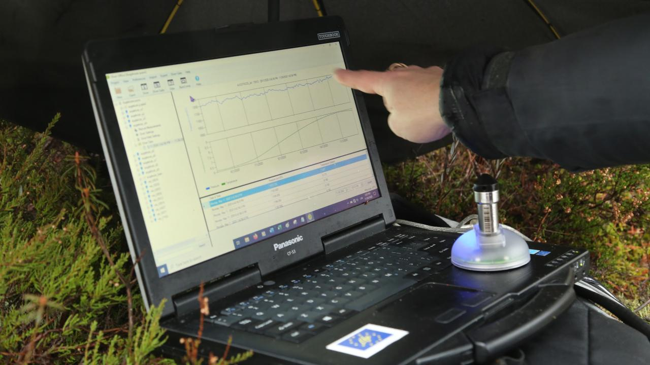
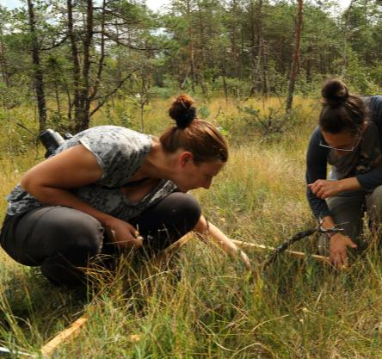
Monitoring of peatland restoration success

Slide 13
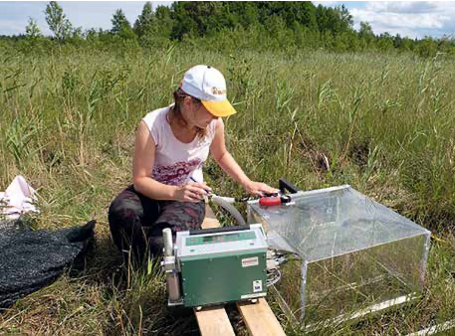
GHG monitoring in the project sites

Slide 14
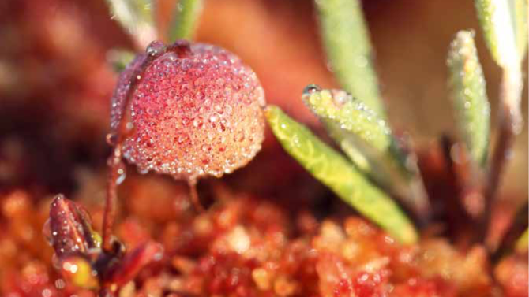
Peatland restoration sites

Slide 15
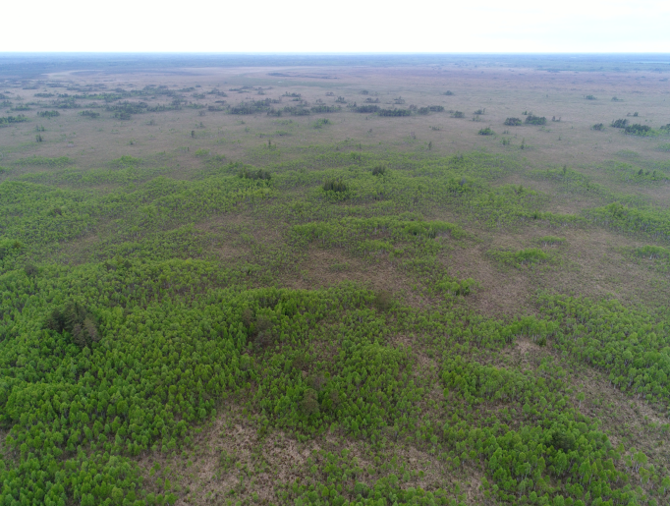
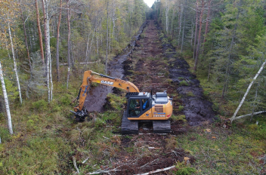
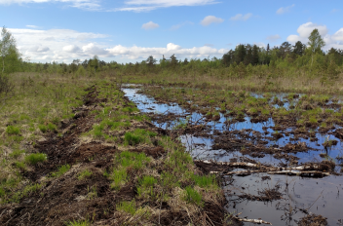
Suursoo-Leidissoo peatland, Estonia

Slide 16
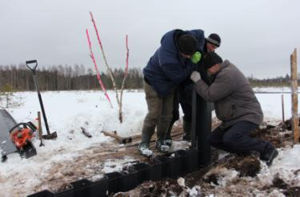
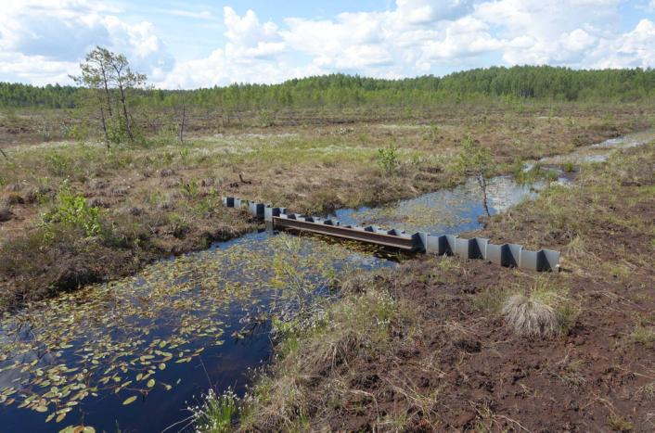
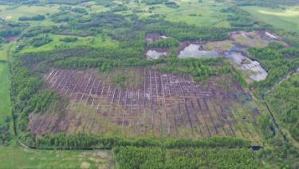
Pūščia peatland, Lithuania

Slide 17
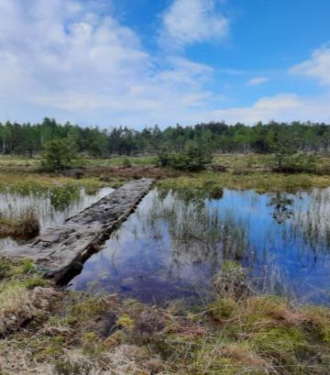
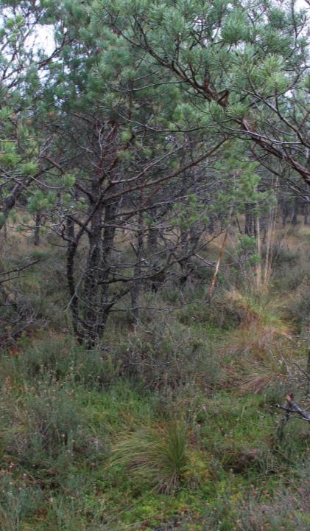
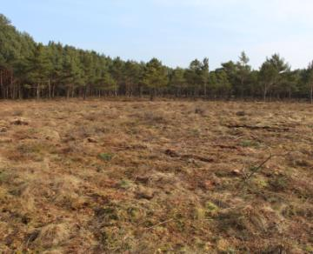
Slovinski National Park, Poland

Slide 18
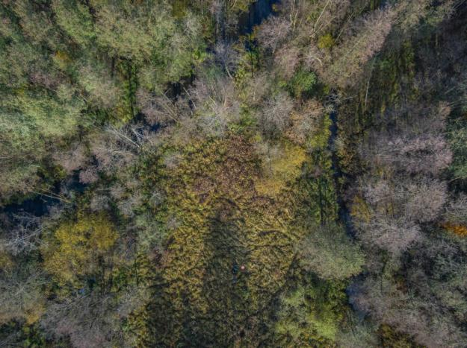
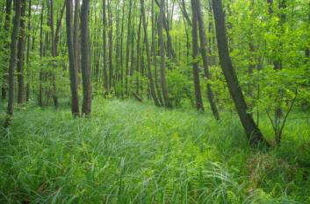
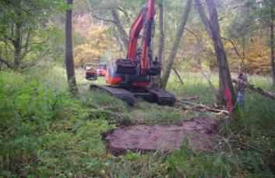
Biesenthalen Becken, Germany

Slide 19
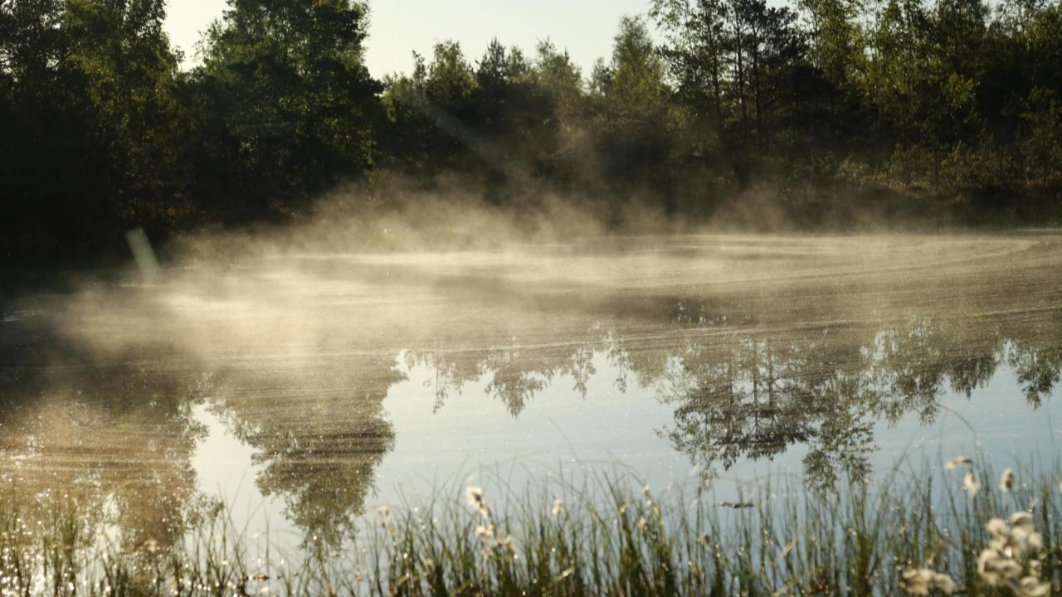
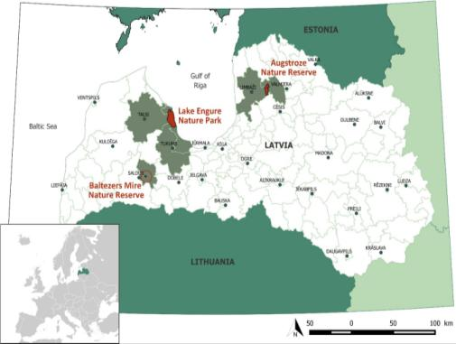
LIFE Peat Restore project sites in Latvia

Slide 20
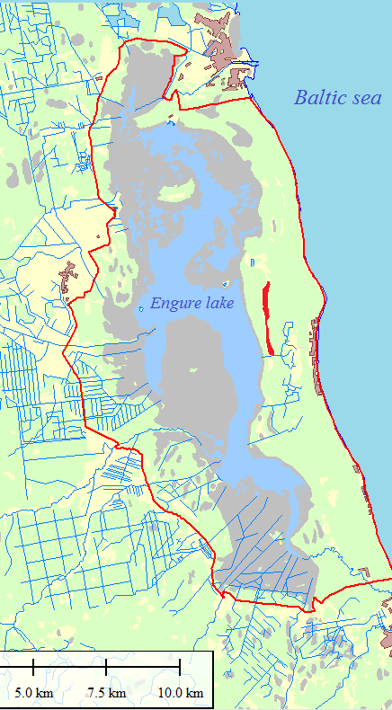
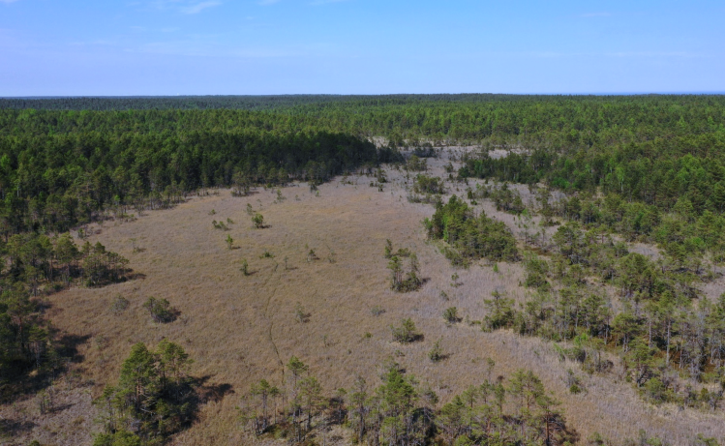
Calcareous fens in Engure Nature Park (total area 19 795 ha)

Slide 21
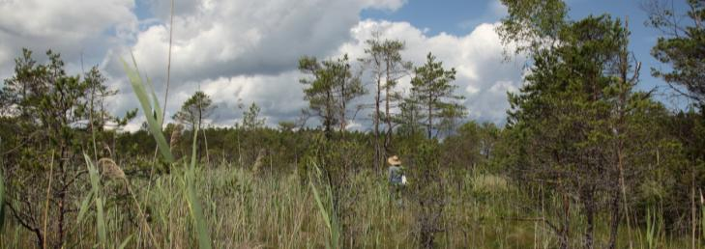
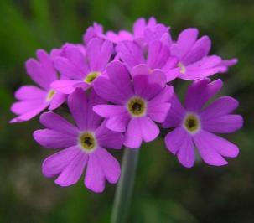
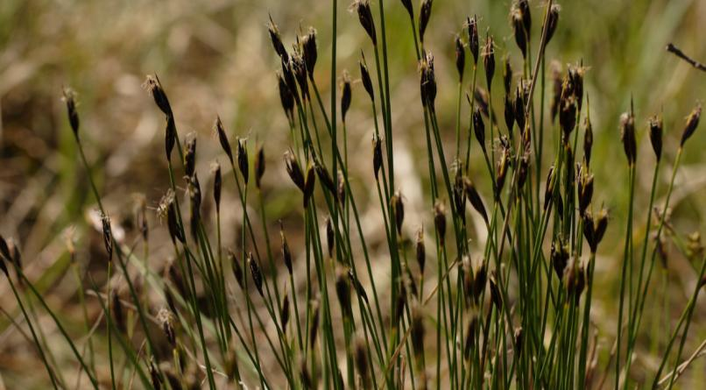
7230 Alkaline fens with Schoenus ferrugineus

Slide 22
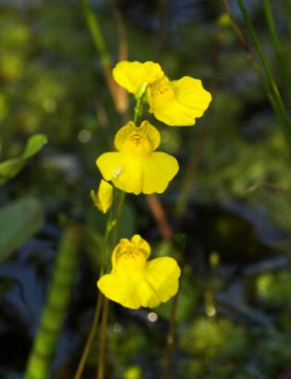
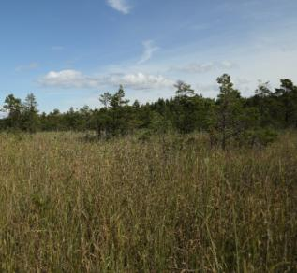
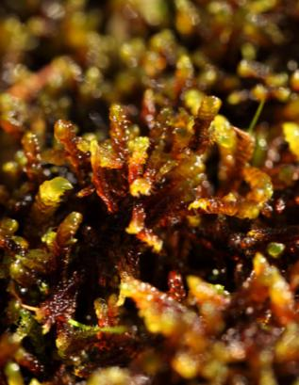
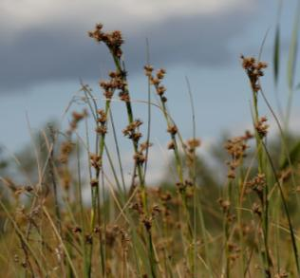
7210 Calcareous fens with Cladium mariscus and species of Caricion davallianae*

Slide 23
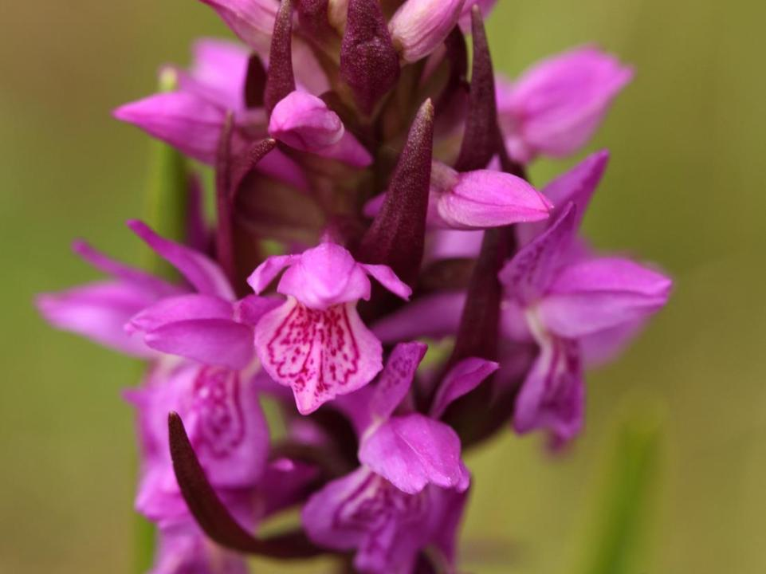
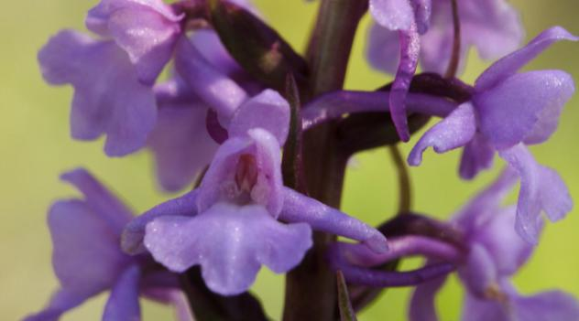
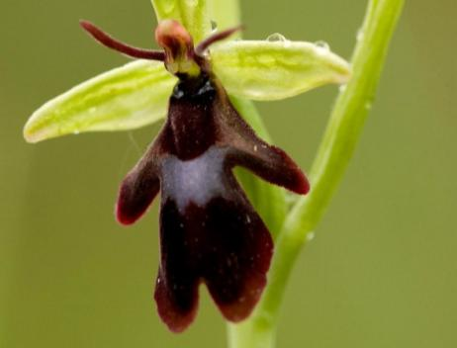

Slide 24
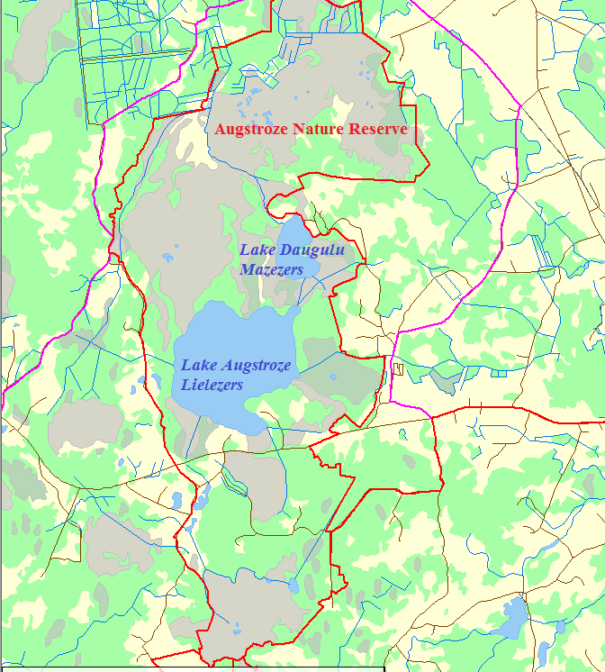
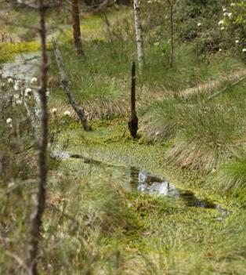
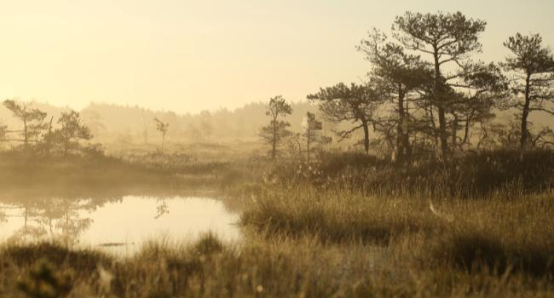
Augstroze Nature Reserve (total area 1880 ha)
The area includes four raised bogs and other types of wetlands (lakes, transition mires and quaking bogs, bog woodlands, swamp forests), among which Madiešēni Mire is the largest one.
The marginal area of Madiešēni Mire has been significantly altered by drainage.

Slide 25
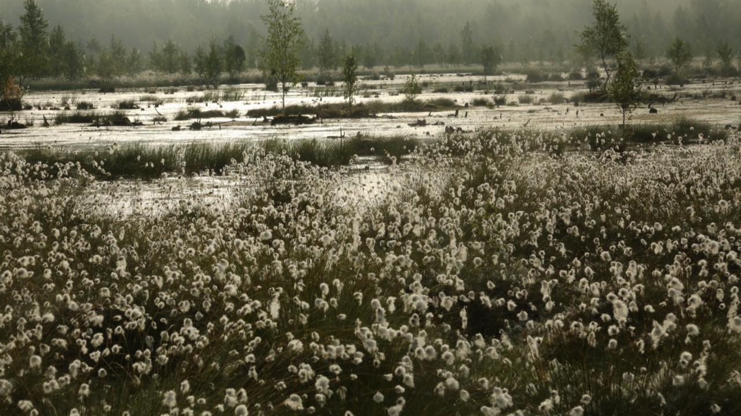
Peatland management

Slide 26
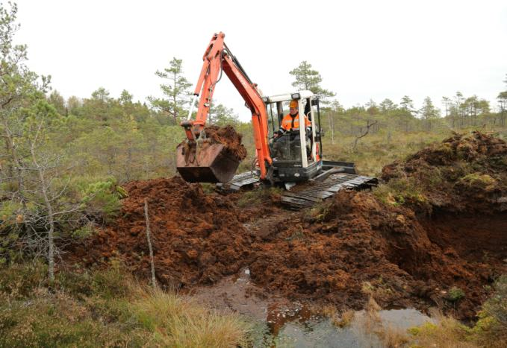
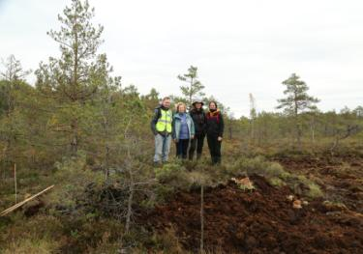
Building of peat dams in Augstroze Nature Reserve, October 2020

Slide 28
Management of a calcareous fen - before and after cutting of trees and shrubs

Slide 29
Vegetation monitoring

Slide 30
Hydrological monitoring

Slide 31
Results of peatland restoration

Slide 32
Conclusions
1. The LIFE Peat Restore project actions helped to restore at least 5300 ha of peatlands in five European countries (Estonia, Latvia, Lithuania, Poland, Germany).
2. The experience of the LIFE Peat Restore project re-confirms the well-known fact that restoring deteriorated peatland ecosystems is a challenging task. It is far more complicated to restore a degraded peatland than preserving it as a functioning natural system that provides multiple ecosystem services including a significant contribution to sequestration of GHGs.
3. The project areas included different peatland types and degrees of degradation. The solutions and approaches to achieve the best result are site-dependent.
4. The project included both well-known techniques that have already proved their efficiency (e.g. peat dams, plastic sheet piling dams, composite dams and similar constructions), less-tested (e.g. reintroduction peat-forming vegetation on bare peat, large scale tree removal, placement of small size timber and branches into ditches, long peat dikes) and innovative solutions (designing and installing floating artificial islands with peat-forming vegetation in post-harvested water basins).
5.Post-harvested and heavily damaged peatlands undergo a long- term succession period before the establishment of favourable conditions for water retention, peat formation, carbon sequestration and providing other ecosystem services.
6. Parallel to planning the peatland restoration measures, it is highly important to involve the stakeholders (local communities, authorities), as lack of information or misunderstandings may lead to significant delays in the implementation.

Slide 33
Recommendations
1.Peatland restoration projects always require time, as not only administrative and technical solutions have to be found, but also the restoration success in a natural system, which usually reacts with a time lag, needs to be observed. According to the LIFE Peat Restore experience, it is recommended to have longer project durations than five years to properly assess the restoration process, to summarise and share the experience and to plan the actions after the end of the LIFE project.
2. Prior to restoring the hydrological regime of the peatland, it is very important to carry out a comprehensive inventory and planning. Hydrological modelling or digital terrain models are tools that help to determine the potential changes, the potential restoration effect and the most appropriate locations of dams or other constructions (several alternatives may be included in the model).
3. In peatland restoration projects, it is highly important to involve a qualified, experienced personnel in all relevant fields during the site surveys, restoration planning and designing the actions.
4. Depending on the peatland site, the degree of human impact and degradation severity, the first results can be observed immediately after restoration. This may also last longer, especially in heavily degraded post-harvested peatland where it is particularly difficult to rise and maintain the water level, i.e. stabilise the water level fluctuations. Therefore, it is highly recommended to continue the monitoring after the end of the restoration project, also to intervene in case the restoration success is threatened.
5. Different management approaches for peatland restoration may be applied for the forest stands established on drained peatlands. In some areas, the trees may be removed, while in some areas they may be left to fall and decay as the water level rises. It is always a trade-off of ecological necessity and economic feasibility, therefore no general recommendation can be given on peatland forest management.

Slide 34
LIFE21-CCM-LV-LIFE PeatCarbon
Peatland restoration for greenhouse gas emission reduction and carbon sequestration in the Baltic Sea region
Project location: Latvia, Finland, Germany and Denmark
Duration : 01/07/22 - 30/06/27
Coordinating beneficiary: University of Latvia
Associated Beneficiaries (12):
Amphi International ApS, Ilmatieteen Laitos, Nodibinājums “Vides risinājumu institūts”, Naturschutzbund Deutschland (NABU) EV, Latvijas valsts mežzinātnes institūts “SILAVA”, Sabiedrība ar ierobežotu atbilstību “AGS Sistēmas”, Silkeborg Kommune, Biedrība “Baltijas krasti”, Luonnonvarakeskus (LUKE), Sabiedrība ar ierobežotu atbilstību “EthnoExpert”, Oulun Yliopisto (UOULU)

Slide 35
Project’s highlights
Internationally applicable Best Practice Book on peatland restoration experience for GHG emission reduction will summarise the project results.
The project follows the success of peatland restoration by monitoring GHG emissions, hydrology and vegetation not only in the newly restored project sites but also those from earlier LIFE projects in Latvia, including the application of remote sensing methods.
The Project will generate new knowledge on peatland restoration for CCM, including certain rewetting methods and techniques tested at the Project pilot sites in Latvia and Finland. These innovations will be transferred to practitioners from Baltic Sea region countries during demonstration workshops.
The Project will also develop innovative restoration success monitoring methods. Joint workshop of remote sensing and ecosystem modeling approach for GHG emission evaluation on peatlands will be specially organised to transfer and spread knowledge and tools developed.
The Ecosystem model of the project sites will be used for upscaling to country level (LV, FI). Regional (Baltic Sea region) simulations will also be performed with the calibrated ecosystem model. Seminars and training events for professionals will be organised.
Pallas Mire, Finland
Melnais Lake Mire, Latvia
Cena and Melnais Lake Mire, Latvia
Notes:
titre

Slide 36
Objectives & scope
Aim of LIFE PeatCarbon Project is the implementation of CCM Measures in peatlands, adaptation and demonstration of innovative tools and applicable methods for GHG monitoring.
The main objectives:
Implementation of CCM measures to reduce greenhouse gas (GHG) emissions in the peatlands of Latvia and Finland, including habitats of EU importance, like 7110* Active raised bogs, 7120 Degraded raised bogs.
Testing innovative monitoring methods for the comprehensive assessment of GHG emissions in Latvia and Finland.
3. Monitoring of CCM measures in 2 restoration sites in Latvia - Lielais Pelečāre and Cena Mire Nature Reserves and 2 in Finland - Välisuo and Matorova Mires, as well as 3 LIFE Project sites where peatland restoration was carried out previously.
4. Development of Guidelines for application of replicable and transferable RS and modelling tools for GHG assessments and inventories.
5. Dissemination, awareness raising and training activities for knowledge building; evaluation of CCM measures; and enhancement of the capacity of national and local authorities to apply the knowledge in practice.
Sudas-Zviedru Mire in the Gauja National Park

Slide 37
Lielais Pelečāre Mire and Cena Mire Nature Reserves

Slide 38
Communication and sharing experience
Web https://life-peat-restore.eu/en/
Photo exhibition on the web page
Films, videos, books
https://life-peat-restore.eu/en/publications/
ART movie about LIFE Peat Restore project https://vimeo.com/ruckaresidency
www.peatcarbon.lu.lv

Slide 39
Thanks for the attention!
Project web page: www.peatcarbon.lu.lv
https://life-peat-restore.eu/en/
Contacts: Dr. Māra Pakalne
E-mail: mara.pakalne@lu.lv

